Slide 1
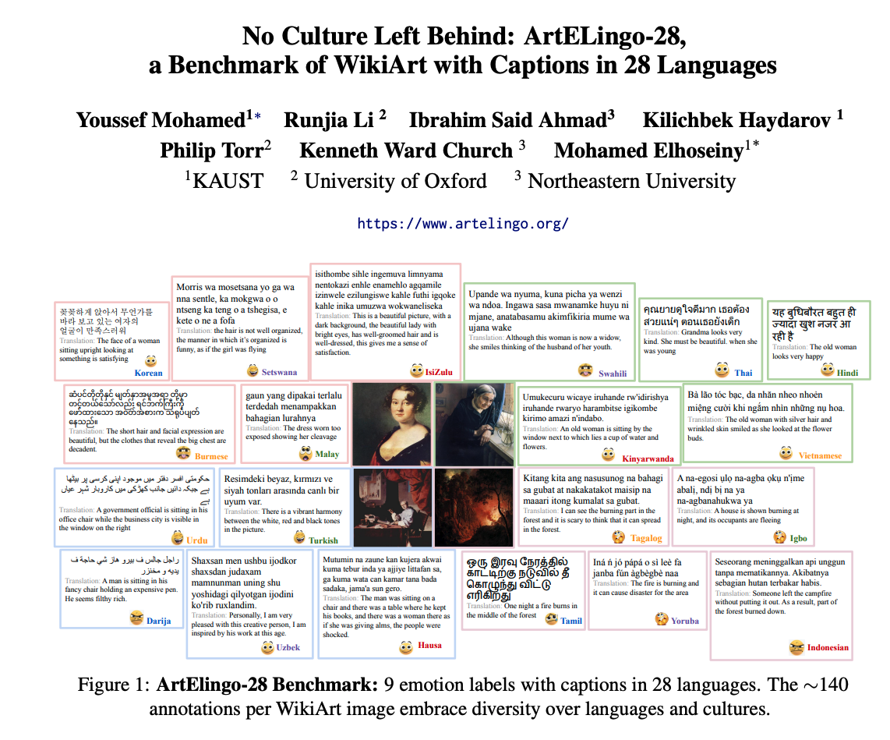

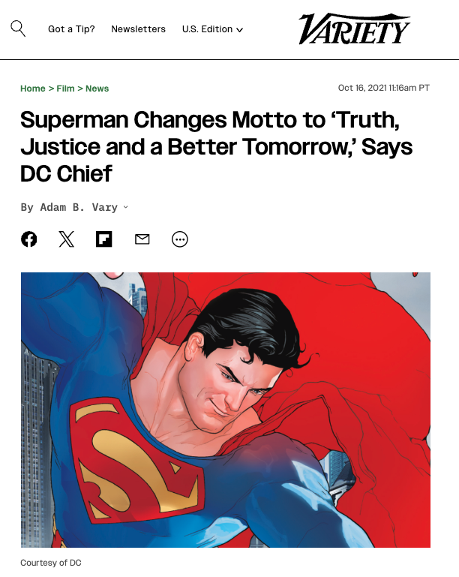

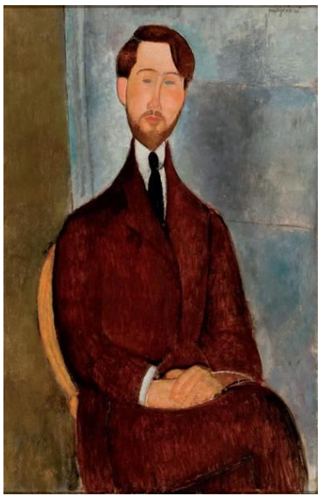
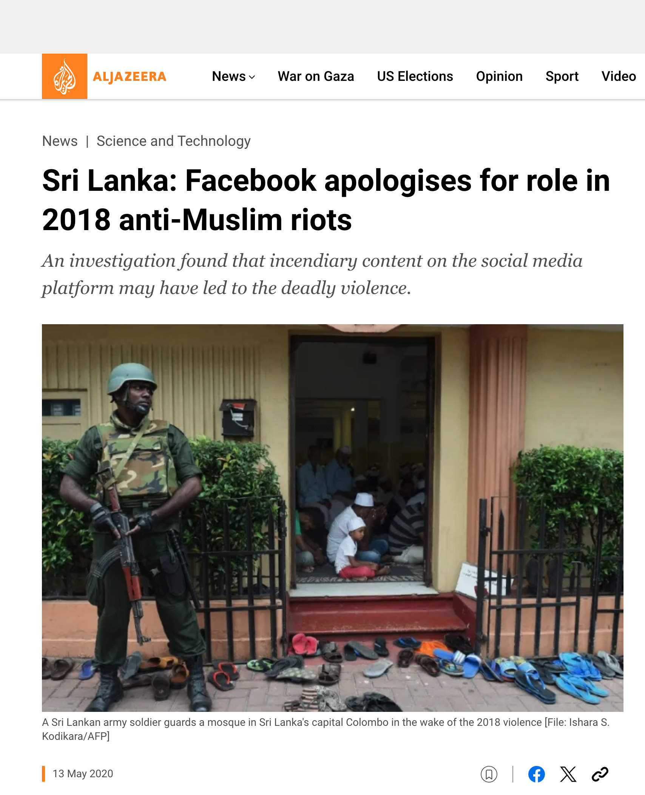


Comparable Corpora: Opportunities for New Research Directions
Kenneth Church
https://kwchurch.github.io/
Northeastern University
Jan 20, 2025
Including these slides

Slide 2
Setting Expectations
Most conference papers present new results
We won’t
This paper will focus more on opportunities
for the audience to make their own contributions
This paper is intended to challenge the community
to think more broadly about
what we can do with comparable corpora.

Slide 3
Agenda
Part 1: Current Status & Opportunities
Part 2: History
Part 3: Suggestions for future

Slide 4
Current Status: Where are we now?
The success of chat bots in many languages demonstrates
the power of comparable corpora (CC)
and pivoting via English
👍
👎

Slide 5

https://www.chronicle.com/article/im-a-student-you-have-no-idea-how-much-were-using-chatgpt

Slide 6
What’s wrong with pivoting via English?

Slide 7
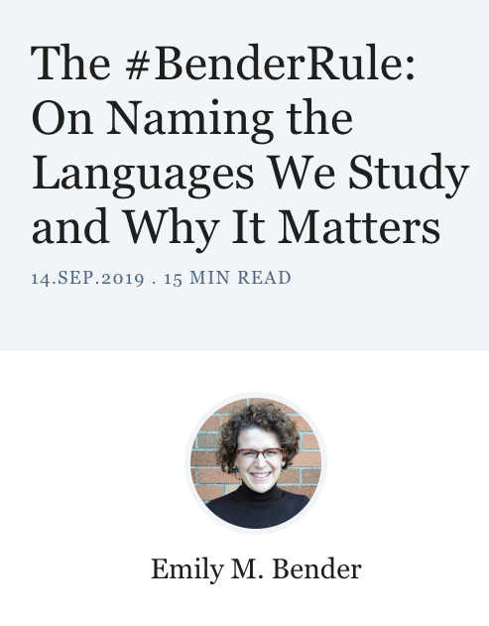

Criticism: ACL is too focused on English https://thegradient.pub/the-benderrule-on-naming-the-languages-we-study-and-why-it-matters/

Slide 8
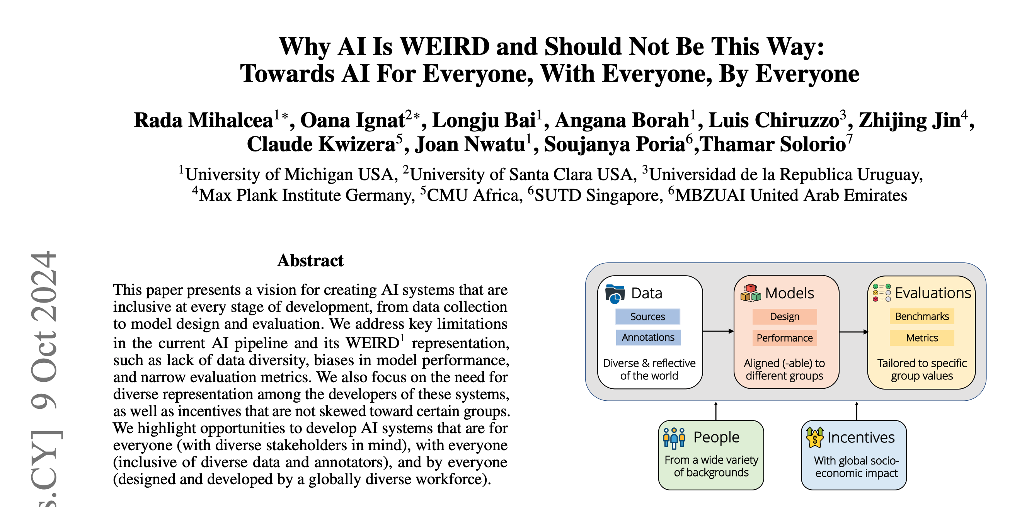

Weird = Western, Educated, Industrialized, Rich, and Democratic

Slide 9
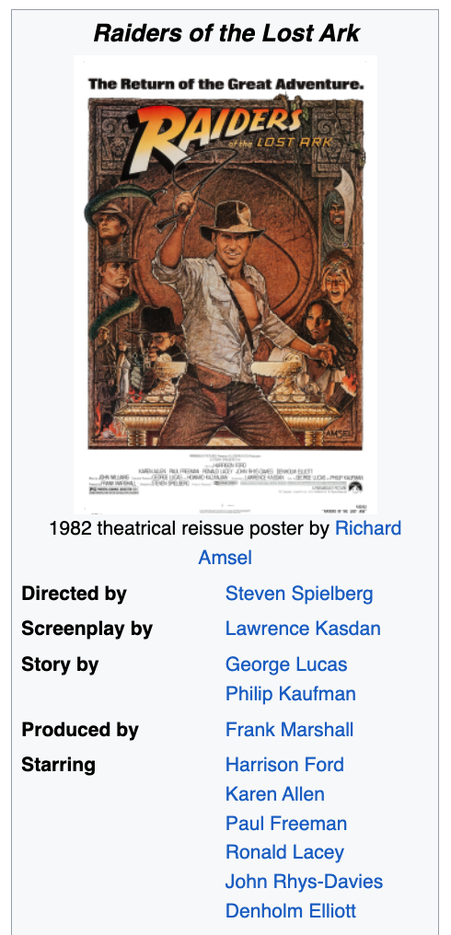


Filter Bubbles (Colonialism) Move Fast and Break Things
Irresponsible AI

Slide 10

Truth, Justice and <fill-mask>
https://www.nytimes.com/2006/06/30/opinion/30iht-ederik.2093103.html?_r=0
WW II
2021

Slide 11
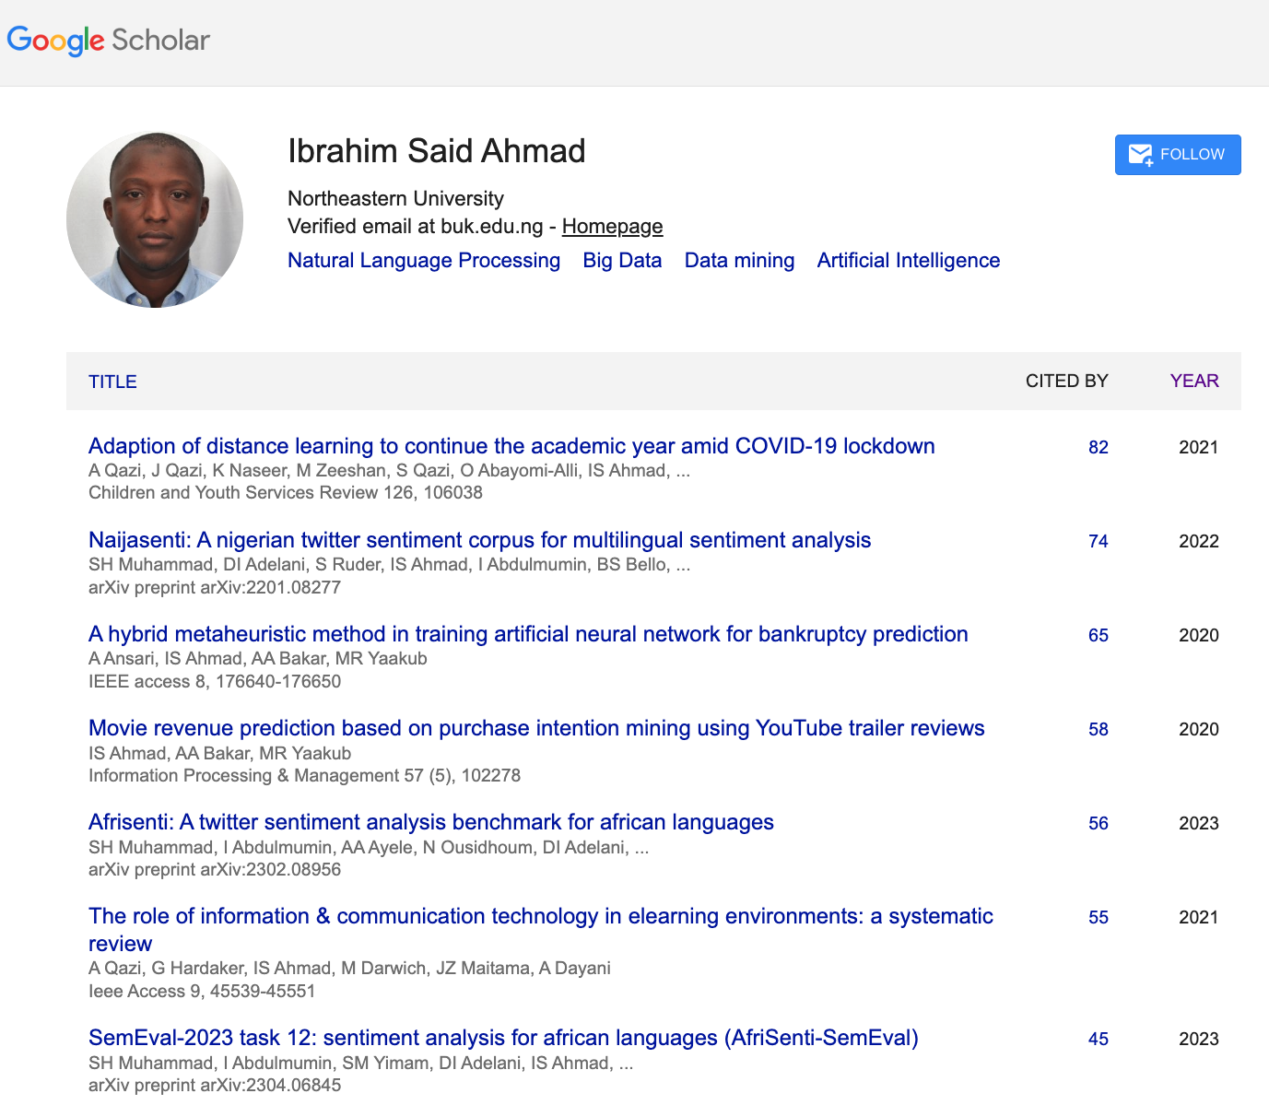
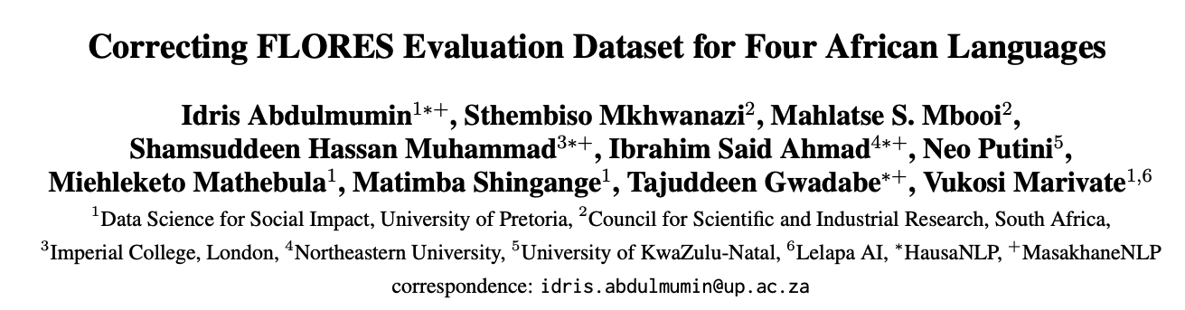
Better to Engage Local Expertise
NLLB
Quality control is relatively weak in 4 African Languages
“A significant part of the translations were suspected
to have been automatically generated”
“Unnatural” natural language
Not even grammatical

Slide 12

Deadly Consequences

Slide 13
Filter Bubble Hypothesis: Anglophones don’t know how bad it is elsewhere
In Nigeria
Tweets are more toxic in Hausa
than in English

Slide 14
Growth Languages

Slide 15

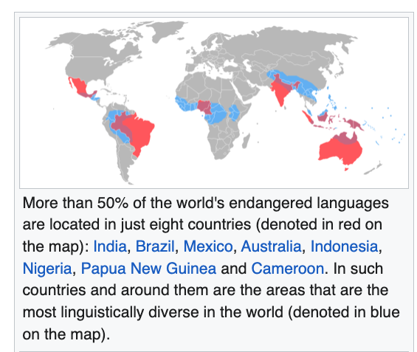
Low Resources & Growth Opportunities
Endangered Languages
https://en.wikipedia.org/wiki/List_of_languages_by_total_number_of_speakers
40 Million Speakers or more
English, Chinese, Hindi, Spanish, Arabic, French, Bengali, Portuguese, Russian, Urdu, Indonesian, German, Japanese, Nigerian Pidgin, Marathi, Telugu, Turkish, Hausa, Tamil, Swahili, Tagalog, Punjabi, Korean, Persian, Javanese, Italian, Gujarati, Thai, Amharic, Kannada, Bhojpuri
https://en.wikipedia.org/wiki/Endangered_language
Better Business Case

Slide 16
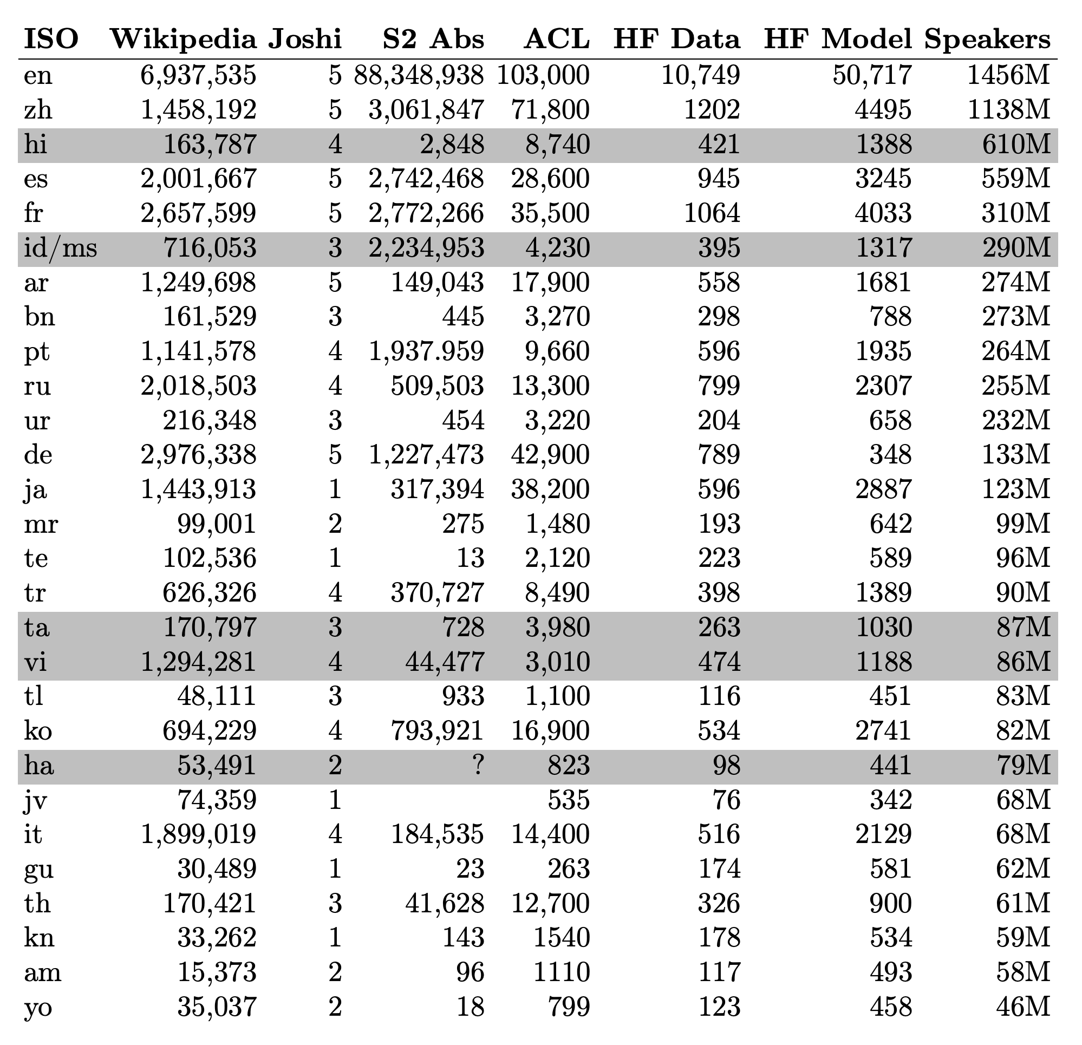
Good News: More resources than we had for English when we started EMNLP
Wikipedia
Joshi Classification
Semantic Scholar (S2)
ACL Anthology
HuggingFace (HF)
Speakers

Slide 17
Agenda
Part 1: Current Status & Opportunities
Part 2: History
Part 3: Suggestions for future

Slide 18
Agenda for Part 1: History
Parallel Corpora
Applications:
Machine Translation (MT)
Word Sense Disambiguation (WSD)
Inappropriate Uses of Translation → Biases
Bilingual Lexicon Induction (BLI)

Slide 19
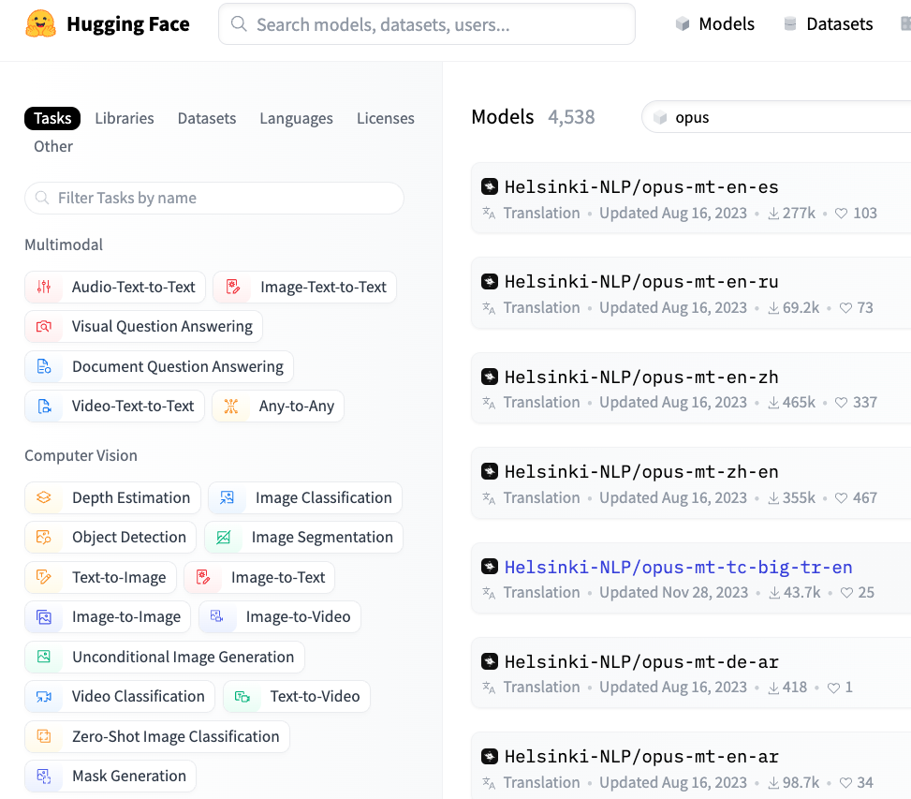
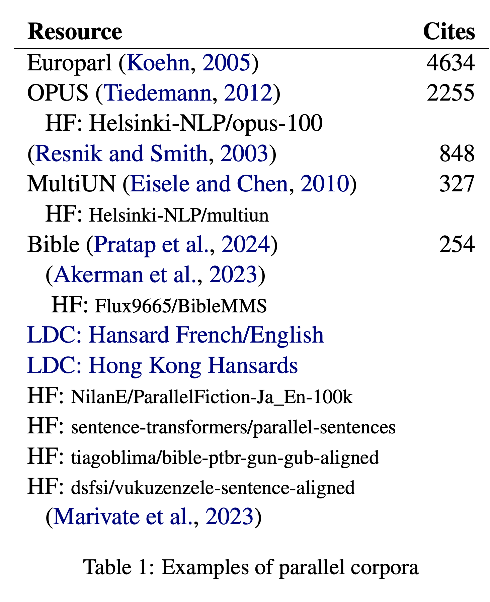

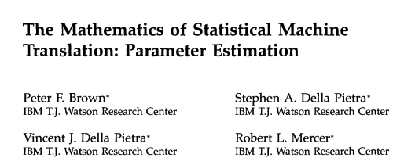
Historical Background: Parallel Corpora

Slide 20
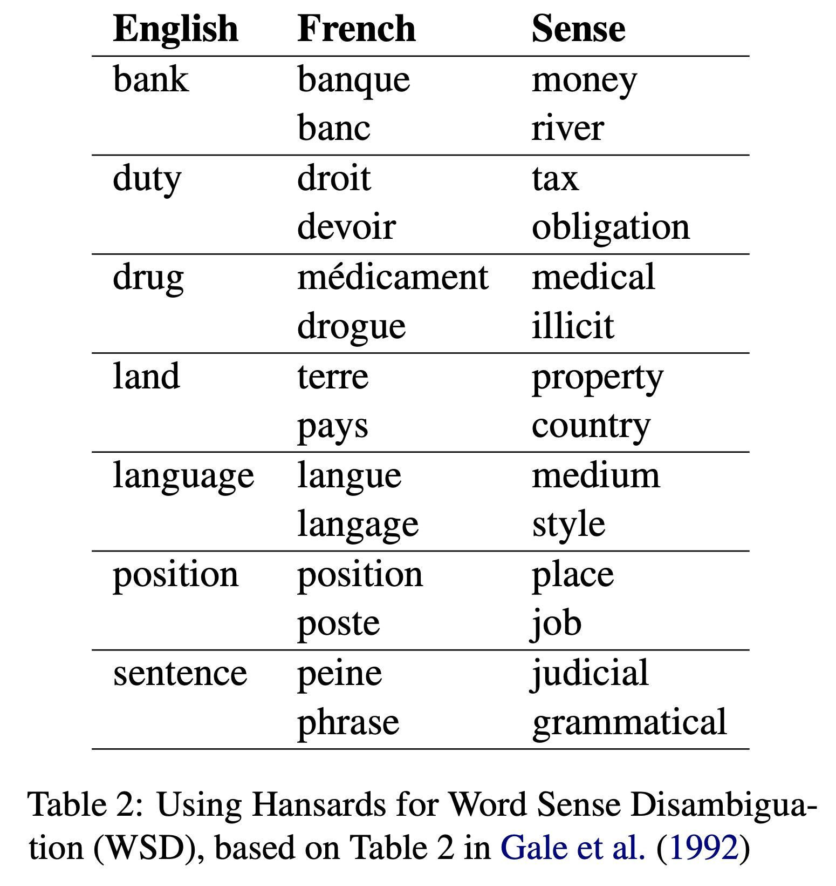
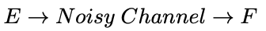
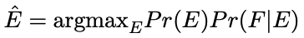
Applications of Parallel Corpora
Machine Translation (MT)
Word Sense Disambiguation (WSD)
Bar-Hillel (1960)
MT depends on WSD
WSD is “AI-Complete”
Gale et al. (1992) flip this arg
Use translations to label senses
bank → banque ➔ “money” sense
bank → banc ➔ “river” sense
After labelling, throw out translations

Slide 21

Monolingual Senses $≠$ Bilingual Senses
Bilingual
Monolingual
Ambiguous in English
But not in French
bank → banque
bank → banc
Equally ambiguous in both languages
interest → intérêt

Slide 22
What’s Wrong with Parallel Corpora?
Availability
Limited genres:
Parliamentary Debates
Bible
Wikipedia:
Widely believed Wikipedia is a comparable corpus,
but there is more translation than people realize
Translationese
“Unnatural” natural language
Anglocentric Biases
Filter Bubbles

Slide 23
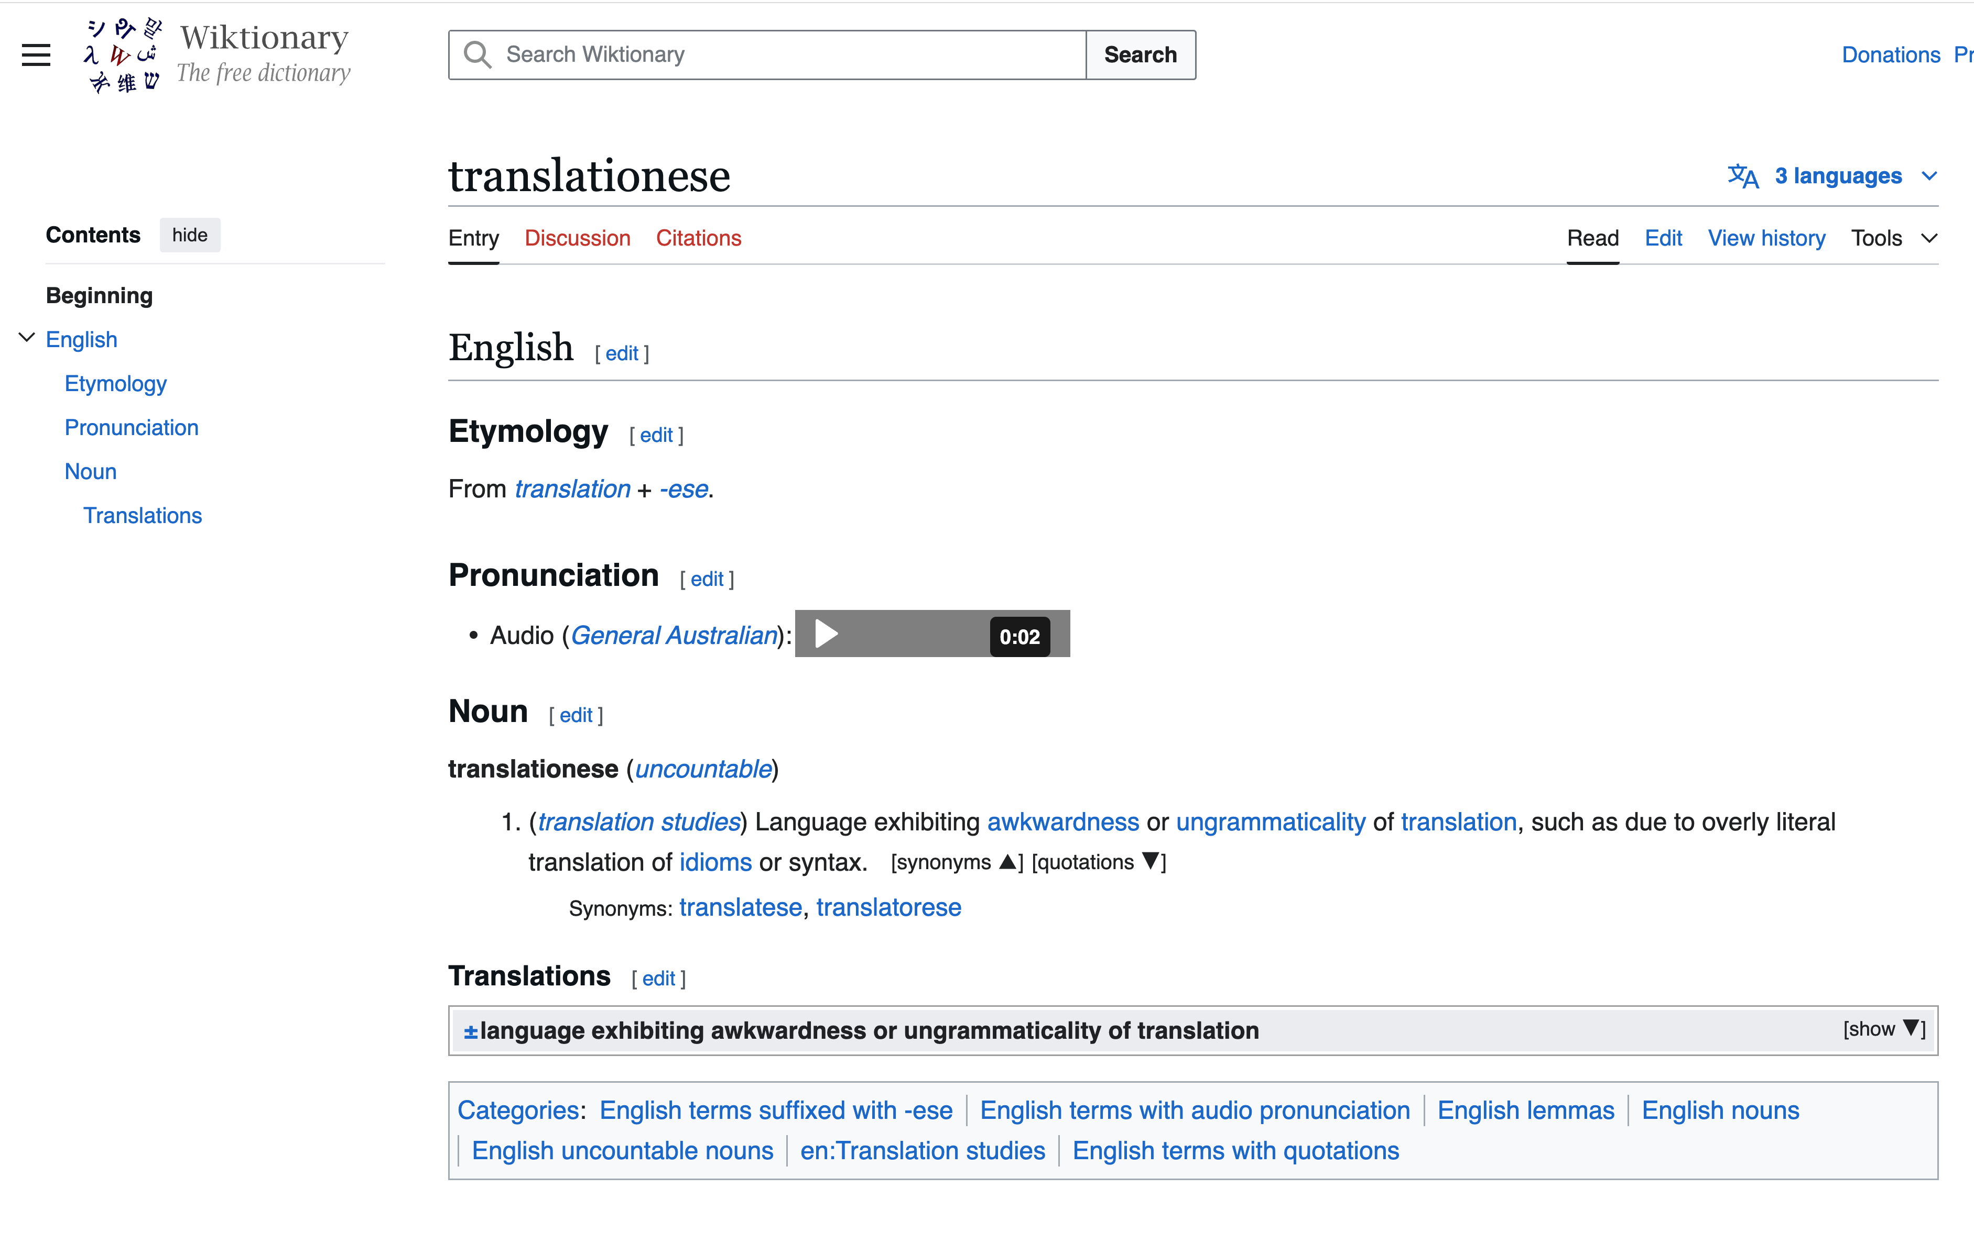

Slide 24
Agenda for Part 1: History
Parallel Corpora
Applications:
Machine Translation (MT)
Word Sense Disambiguation (WSD)
Inappropriate Uses of Translation → Biases
Bilingual Lexicon Induction (BLI)

Slide 25
Too Much Translation in Corpora/Resources (English is often used as a Pivot Language)
More recent
XNLI: translation of NLI
Wikipedia: more translation than one might have thought
Less recent
WordNet
NRC VAD

Slide 26
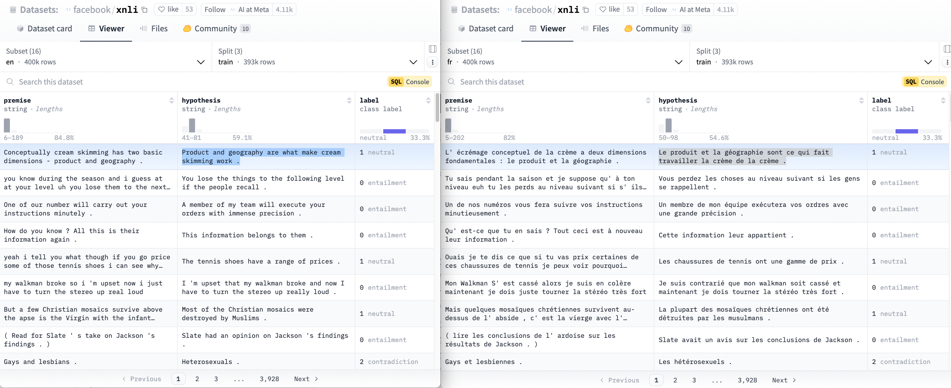
XNLI: label ~ premise + hypothesis Translated English NLI task to 15 Languages cream skimming → la crème de la crème ??

Slide 27
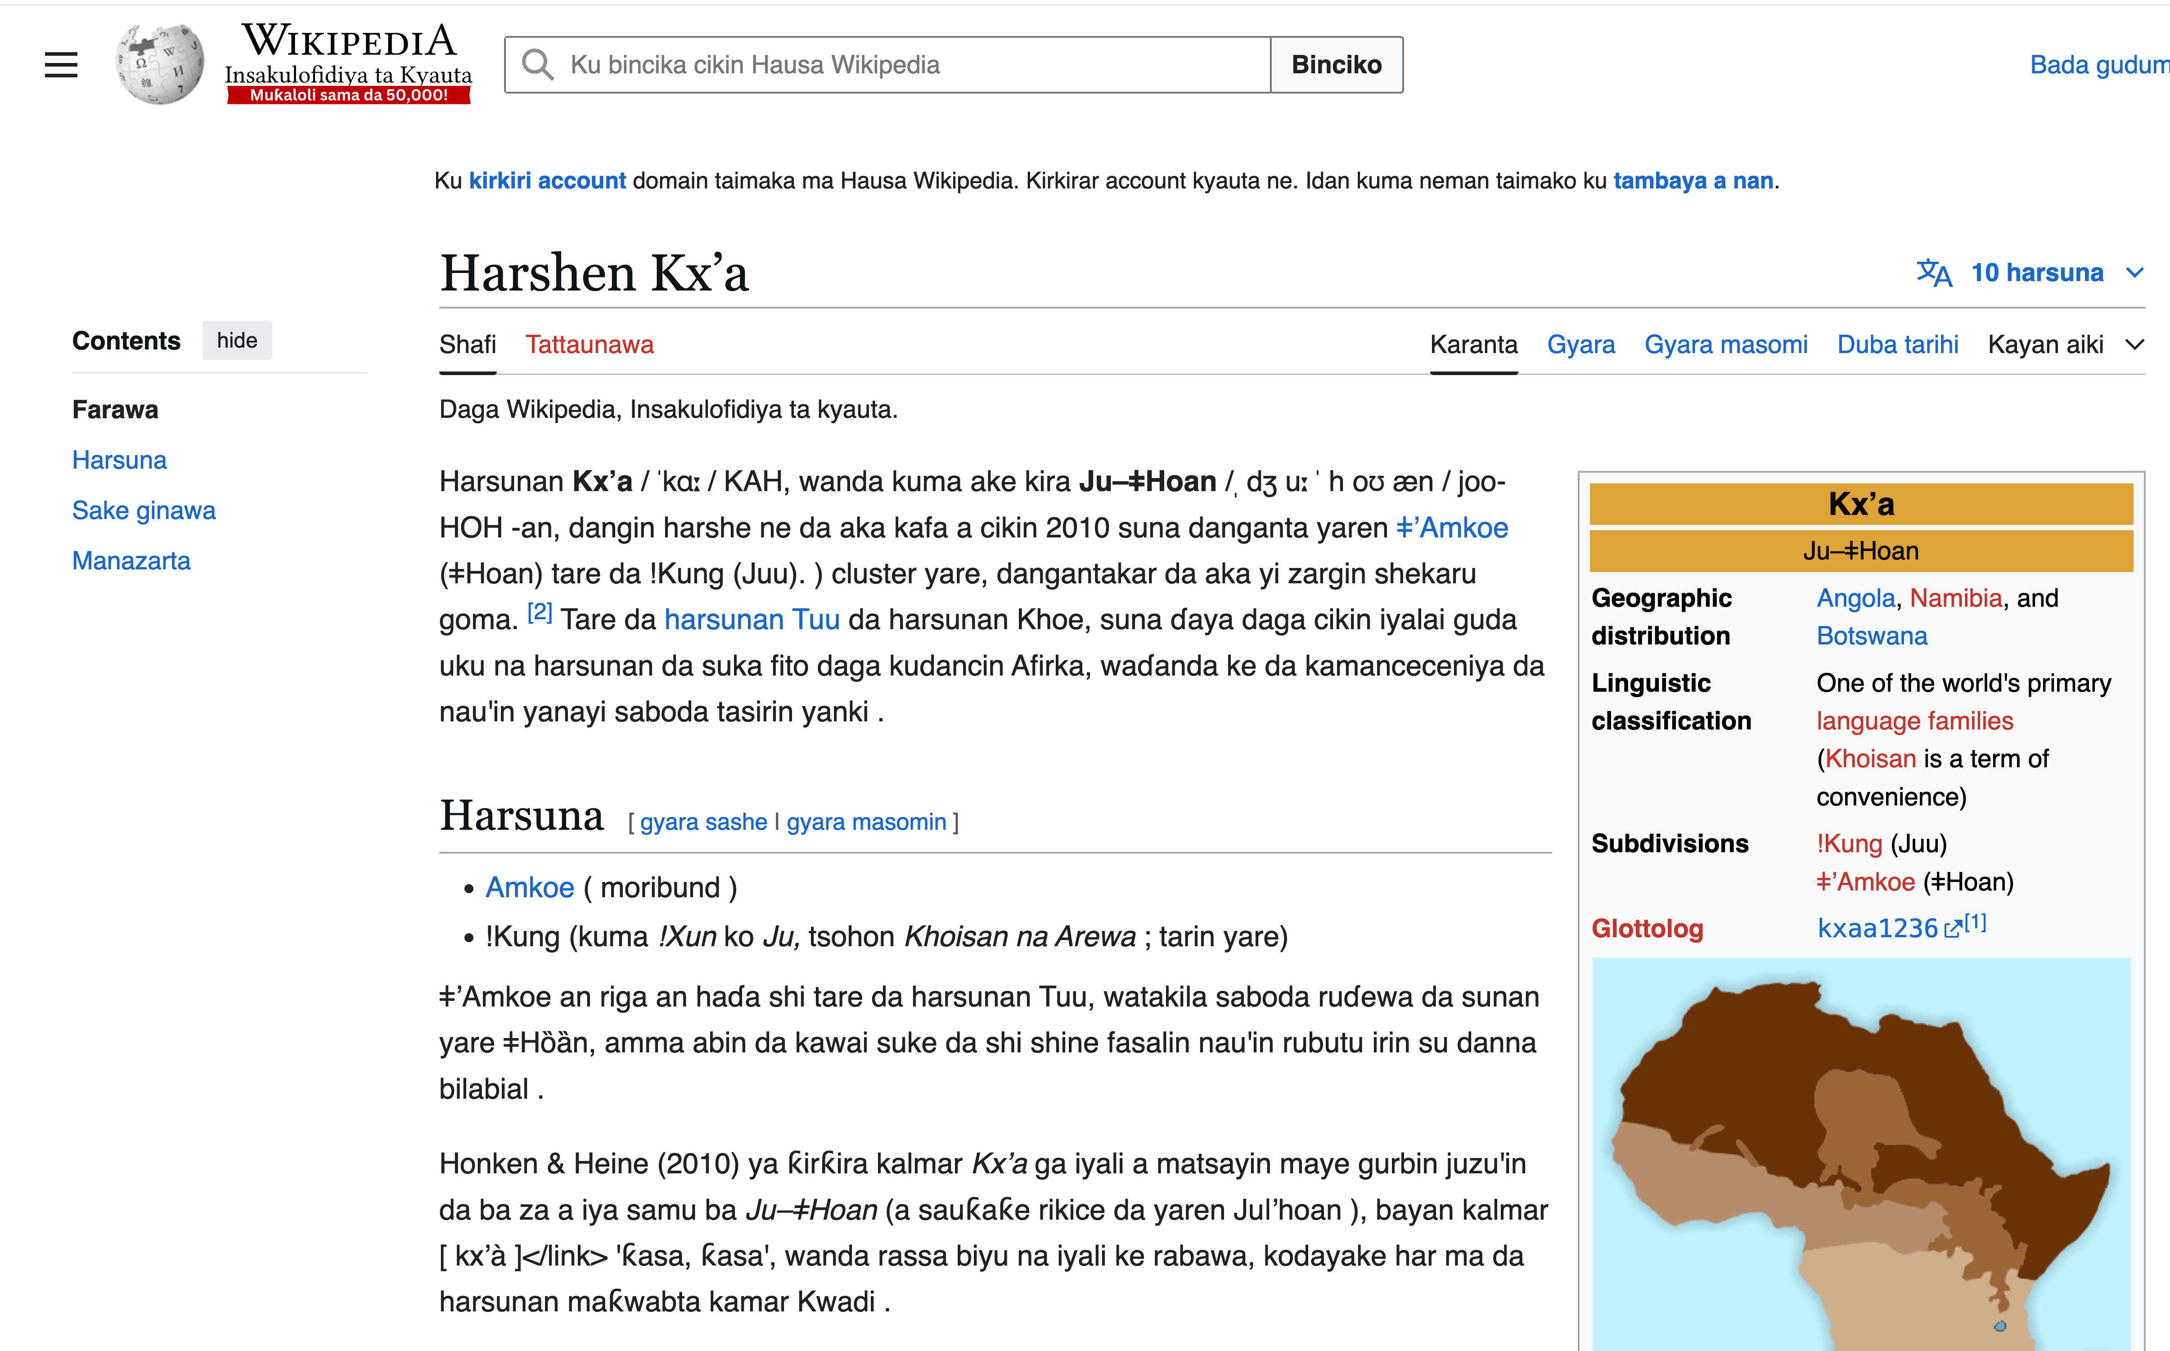
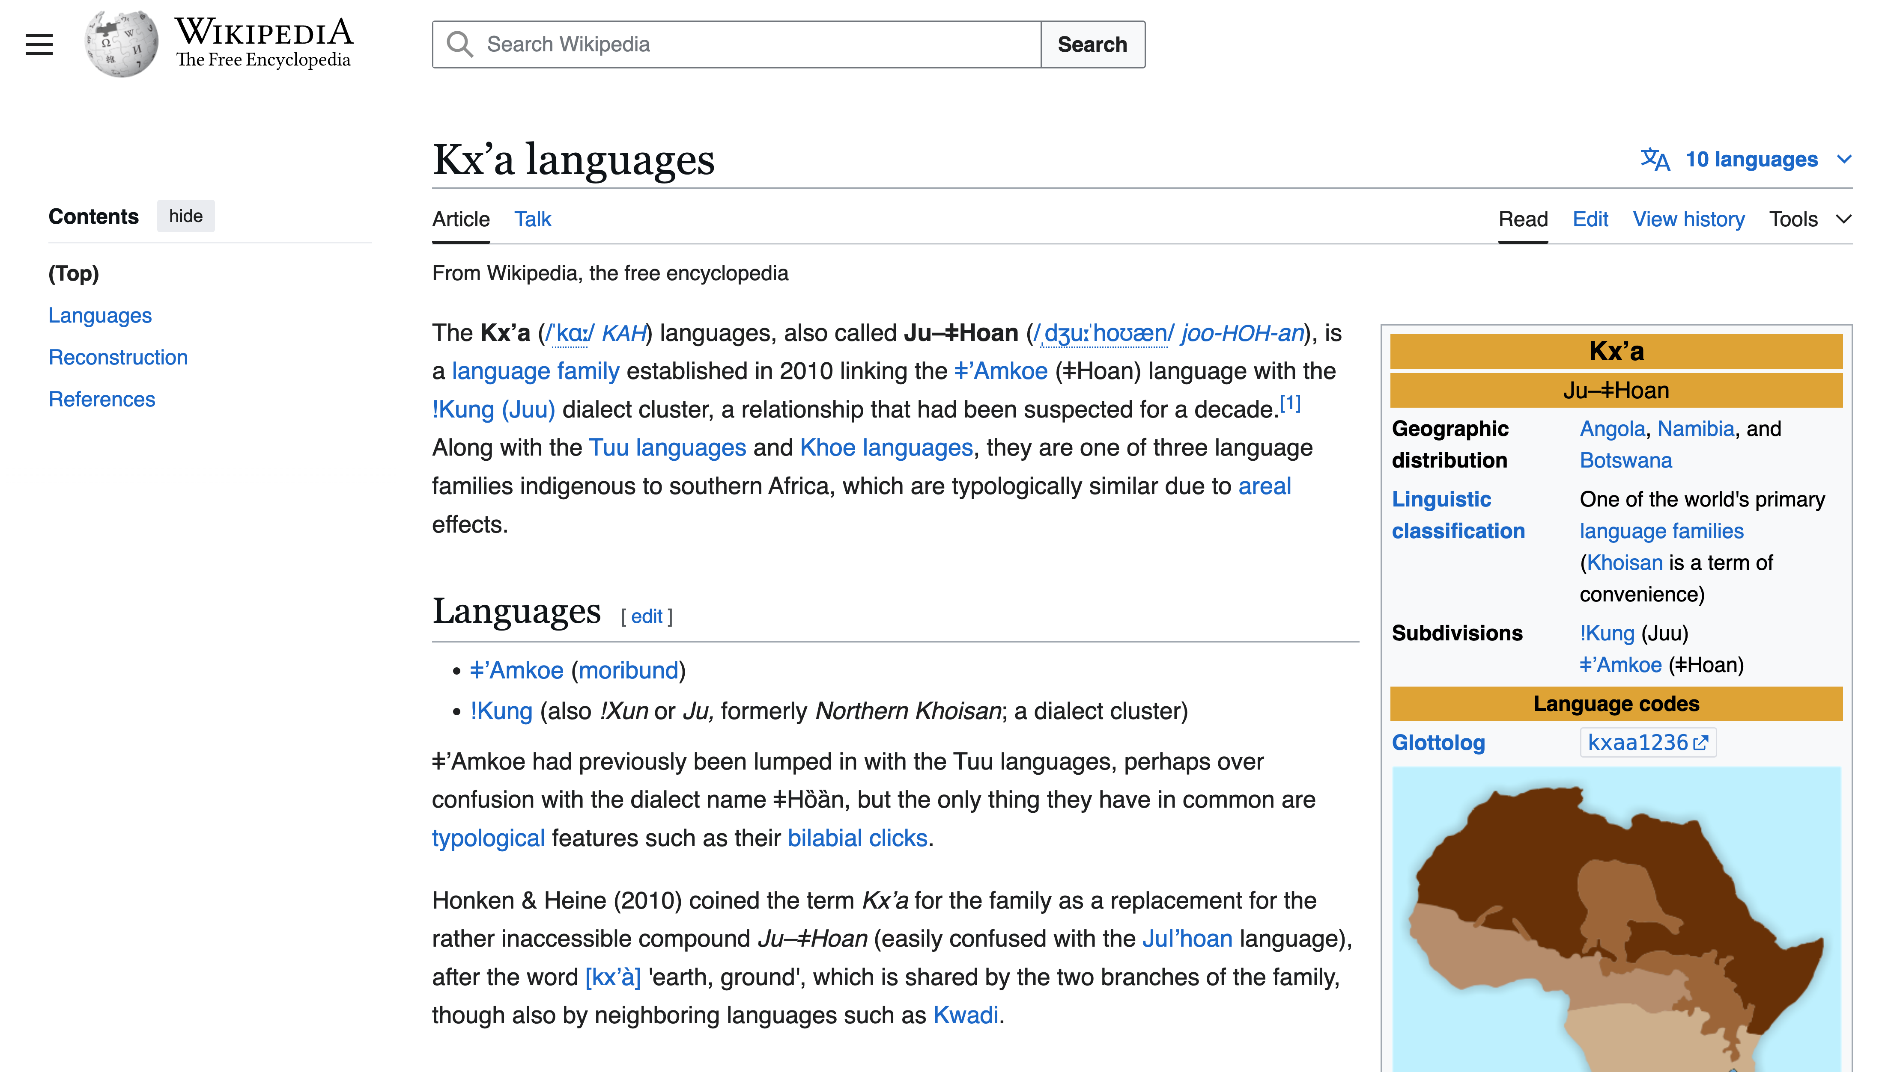
It is widely (and incorrectly) believed that Wikipedia is Translation-Free
https://ha.wikipedia.org/wiki/Harshen_Kx%CA%BCa
https://en.wikipedia.org/wiki/Kx%CA%BCa_languages

Slide 28
How much translation is there in Wikipedia? Answer: 90% of Hausa Pages

Slide 29
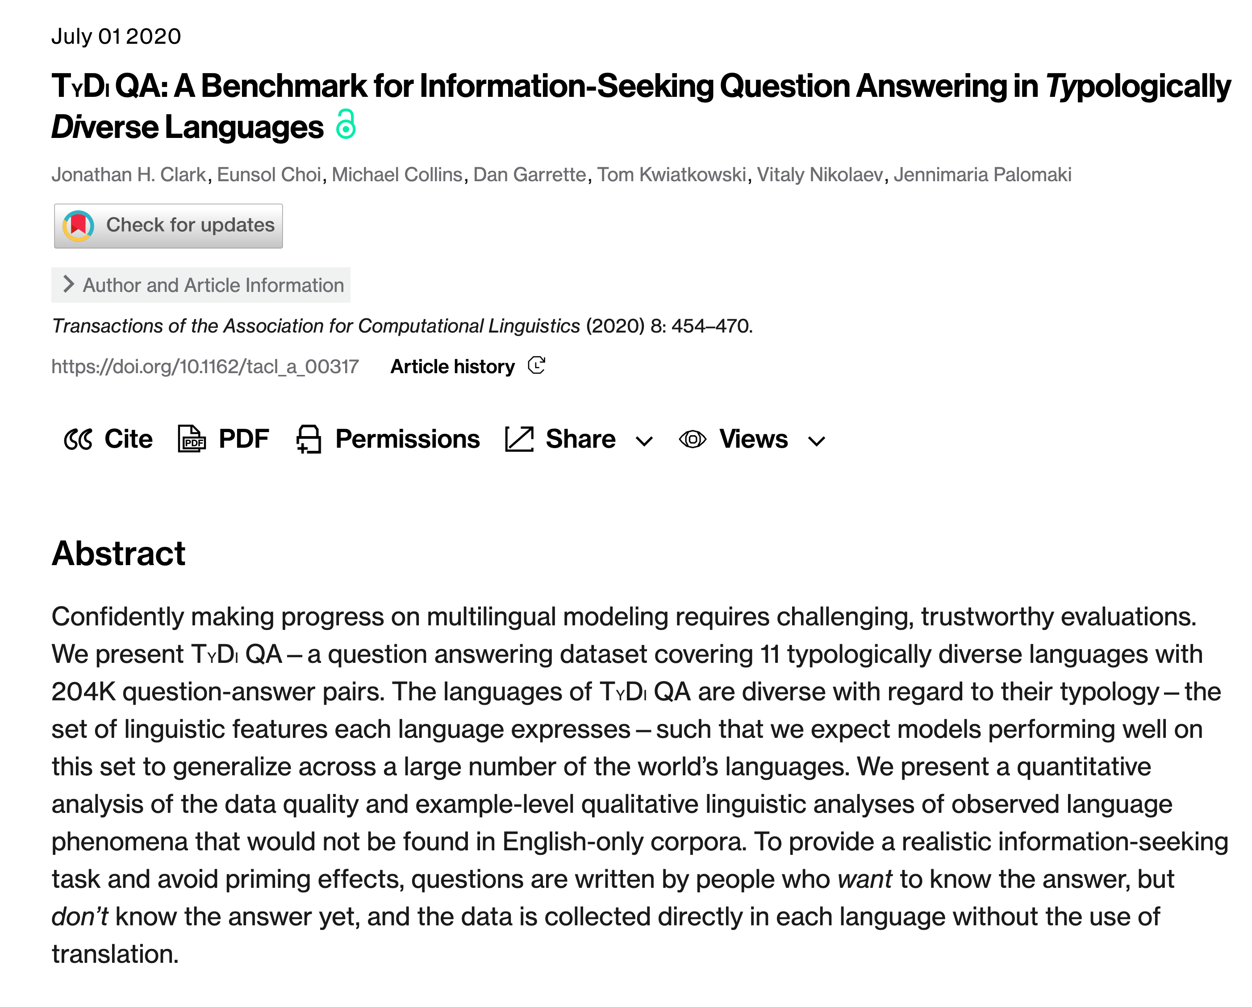
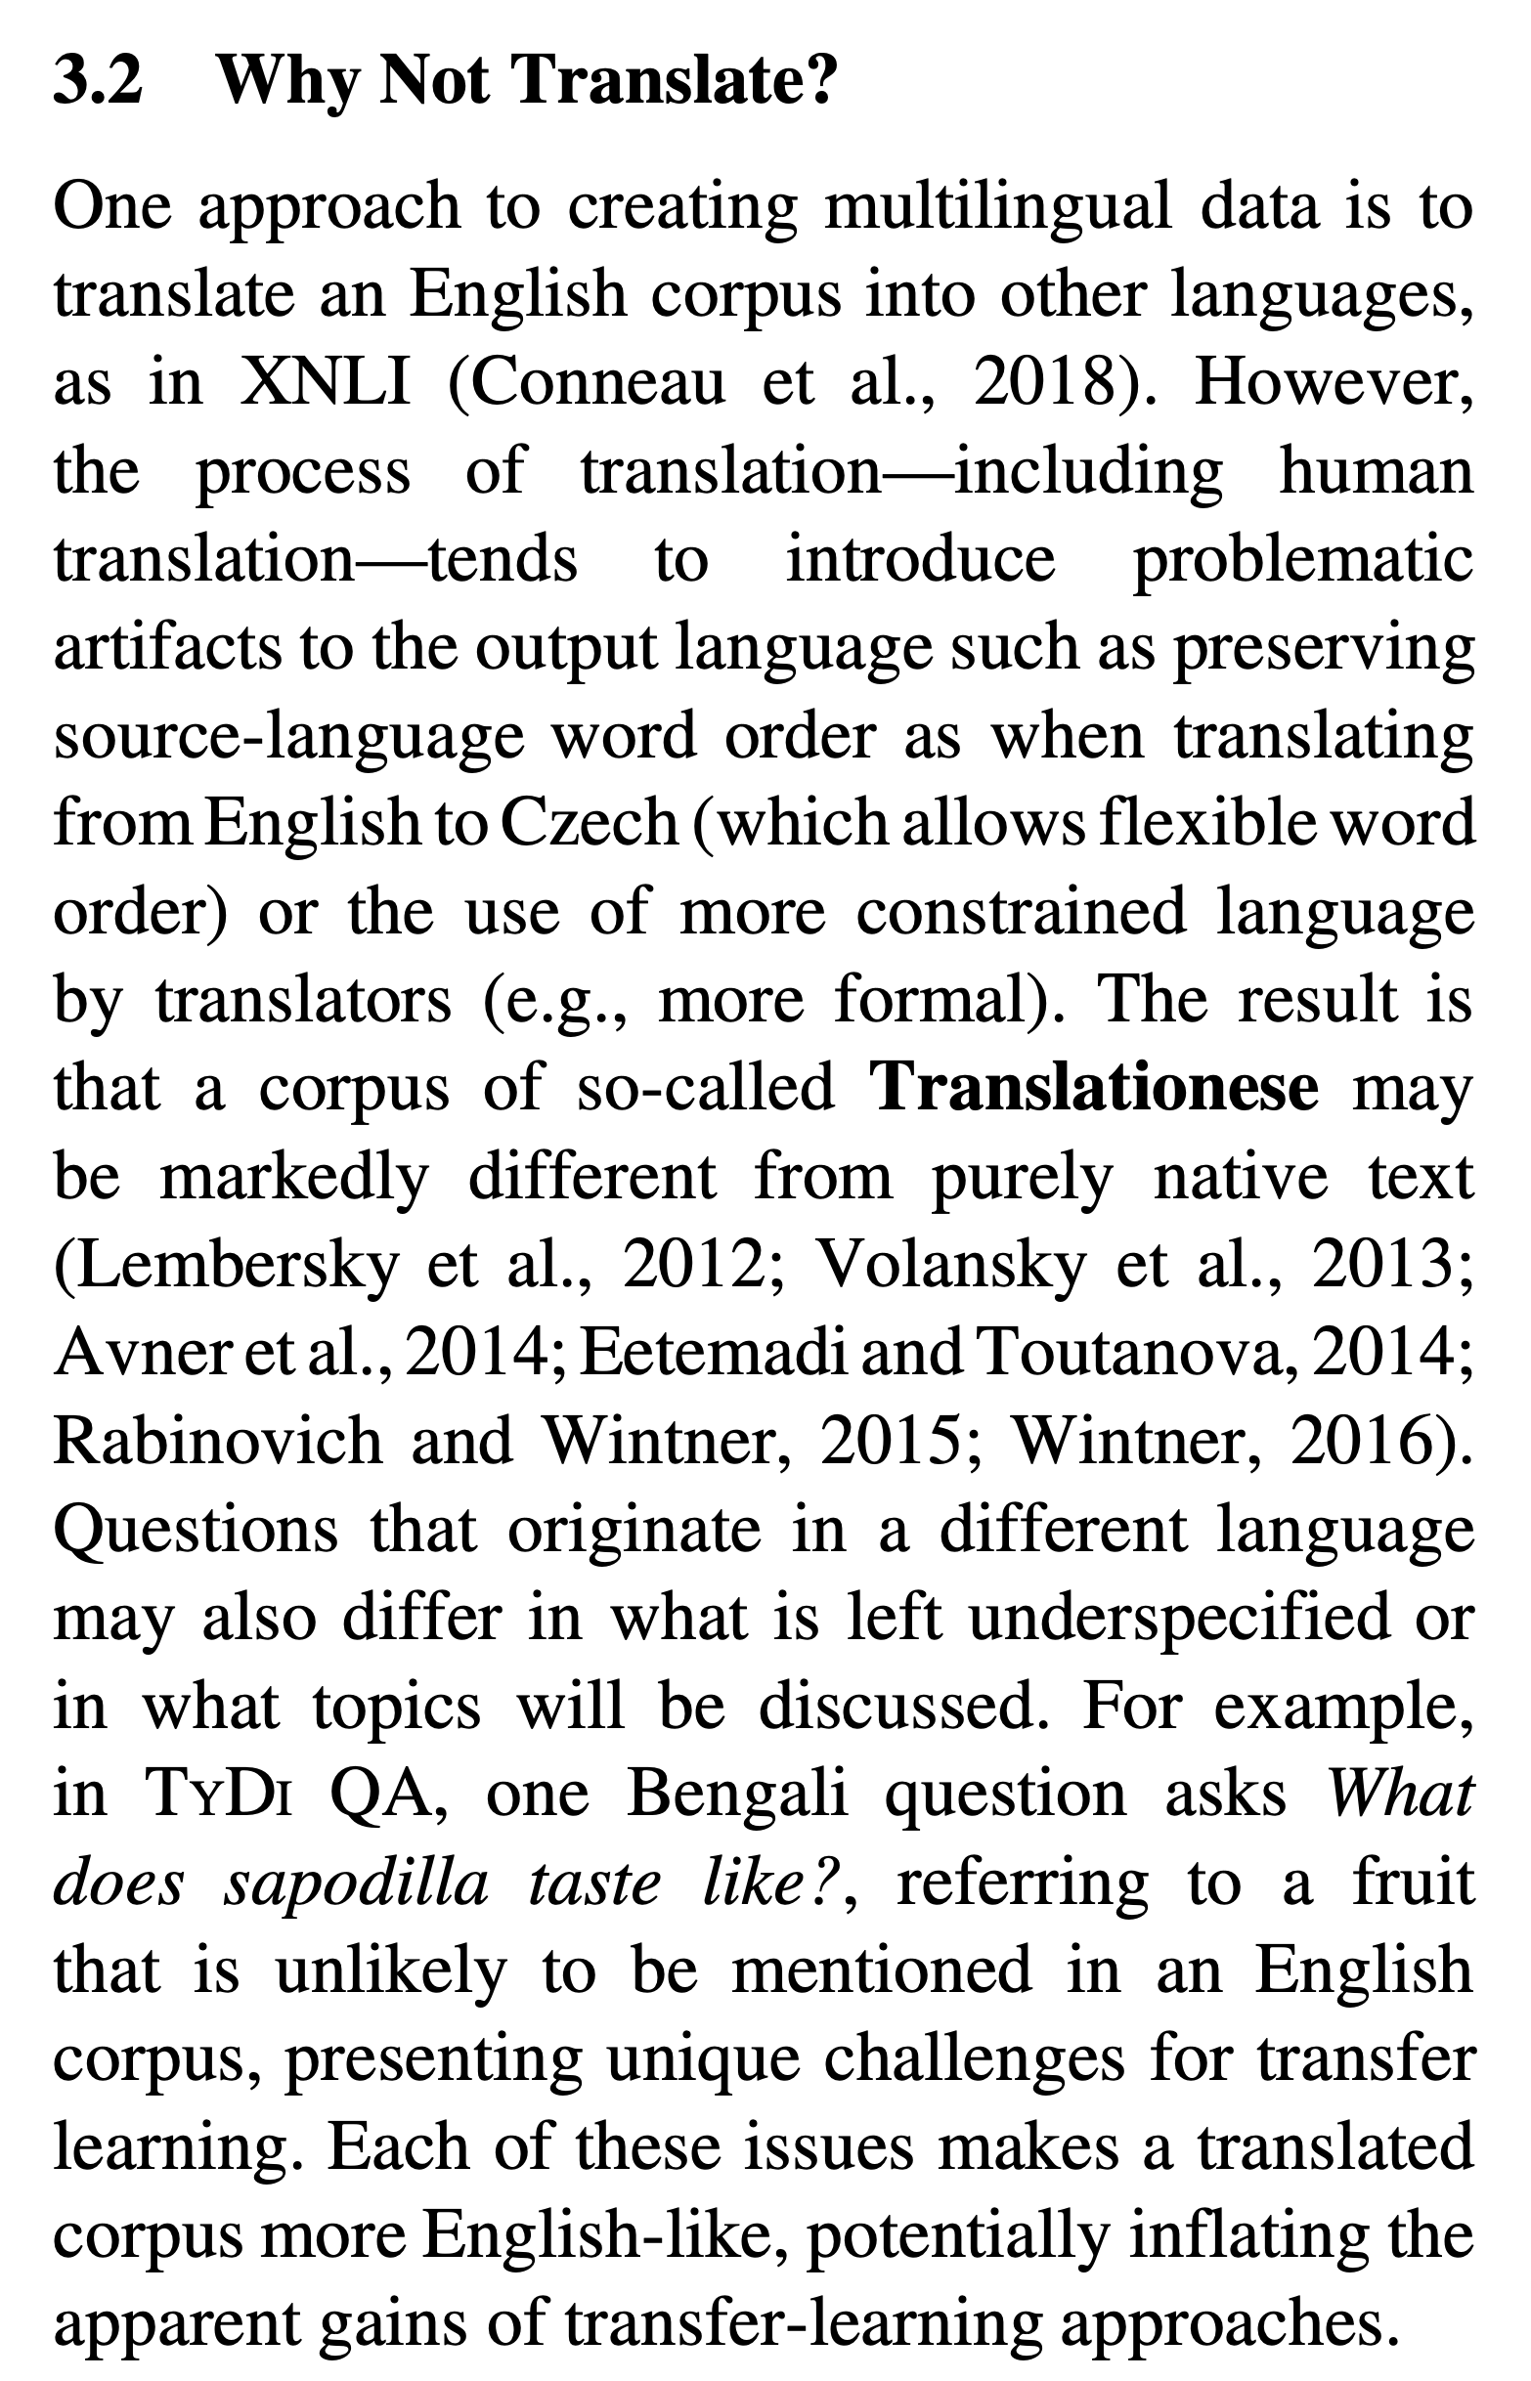

Slide 30
Too Much Translation in Corpora/Resources (English is often used as a Pivot Language)
More recent
XNLI: translation of NLI
Wikipedia: more translation than one might have thought
Less recent
WordNet
NRC VAD

Slide 31
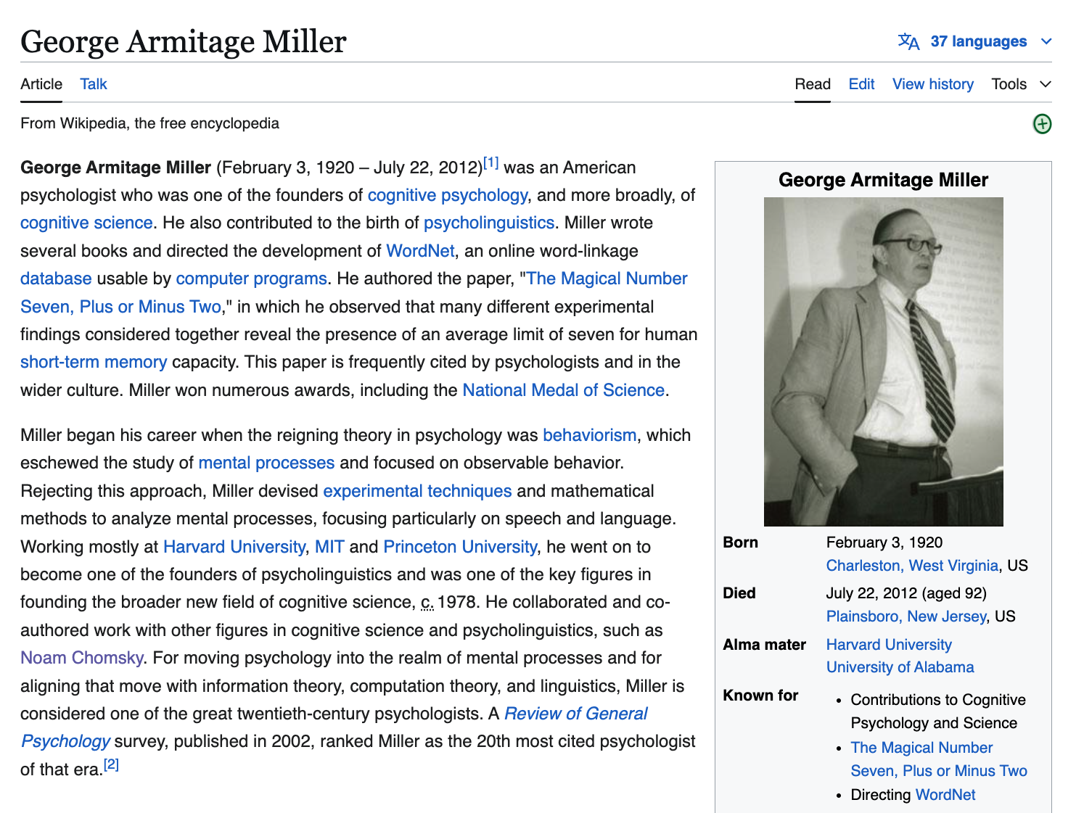
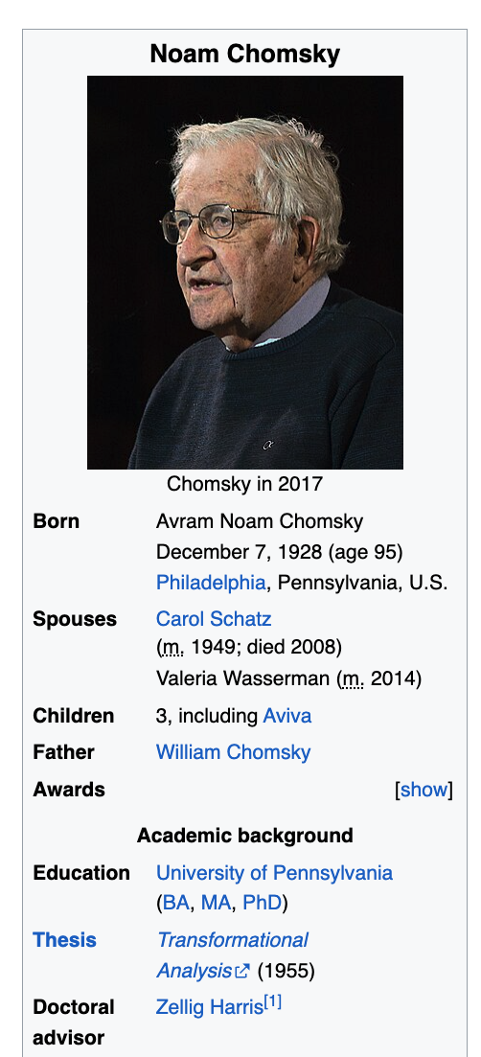

Slide 32
Avoid Translation (Pivoting via English)
WordNet
Word Sense Disambiguation (WSD)
wn.synset('dog.n.01').lemma_names('fra')
['canis_familiaris', 'chien']
wn.synset('cat.n.01').lemma_names('fra')
['chat']
wn.synset('house.n.01').lemma_names('fra')
['maison']
wn.synset('bank.n.01').lemma_names('fra')
['banque', 'rive’]
Assumes English ontology is universal
Ontology: is-a links between synsets, etc.
Supports 32 languages

Slide 33
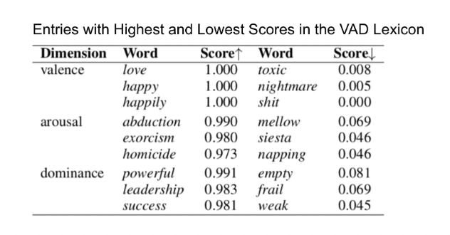
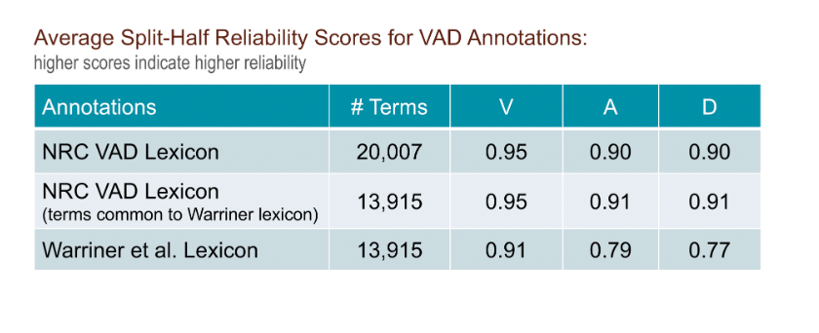
Avoid Translation (Pivoting via English) NRC-VAD (Uses Google Translate)
Hausa | English | Valence | Arousal | Dominance
aaaaaaa | aaaaaaah | 0.48 | 0.61 | 0.29
aaaah | aaaah | 0.52 | 0.64 | 0.28
ardvark | aardvark | 0.43 | 0.49 | 0.44
abin mamaki | aback | 0.39 | 0.41 | 0.29
abacus | abacus | 0.51 | 0.28 | 0.49
abalone | abalone | 0.50 | 0.48 | 0.41
Assumes English ontology is universal

Slide 34
Agenda for Part 1: History
Parallel Corpora
Applications:
Machine Translation (MT)
Word Sense Disambiguation (WSD)
Inappropriate Uses of Translation → Biases
Bilingual Lexicon Induction (BLI)

Slide 35
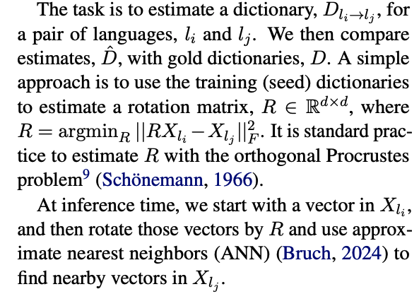
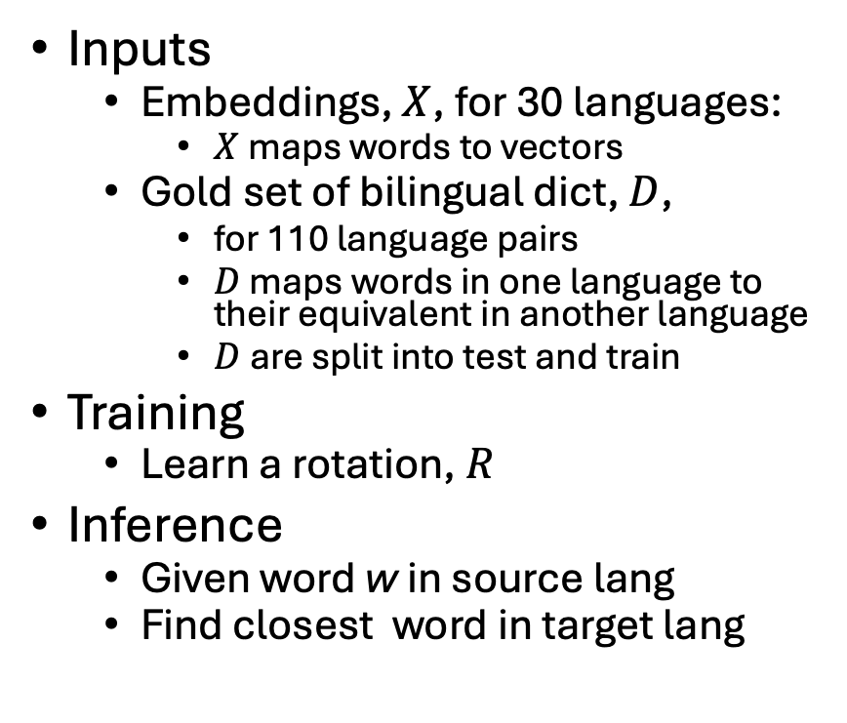
BLI (Bilingual Lexicon Induction) MUSE Task: An Application of Comparable Corpora
Inputs
Embeddings, $X$, for 30 languages:
$X$maps words to vectors
Gold set of bilingual dict, $D$,
for 110 language pairs
$D$ maps words in one language to their equivalent in another language
$D$are split into test and train
Training
Learn a rotation, $R$
Inference
Given word w in source lang
Find closest word in target lang

Slide 36
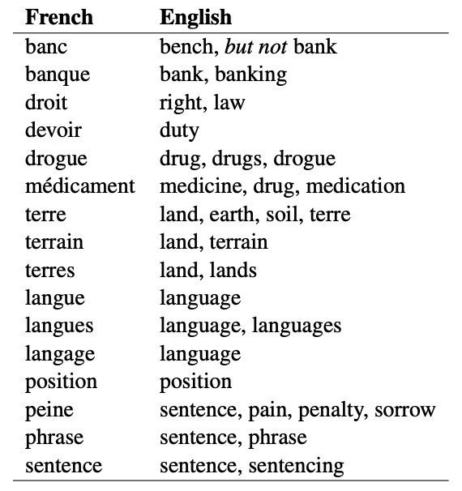
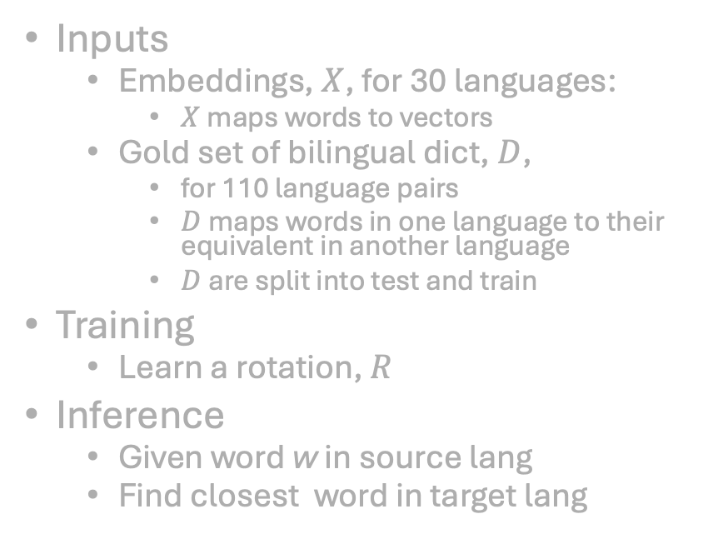
MUSE Task
MUSE Gold Dictionary
Inputs
Embeddings, $X$, for 30 languages:
$X$maps words to vectors
Gold set of bilingual dict, $D$,
for 110 language pairs
$D$ maps words in one language to their equivalent in another language
$D$are split into test and train
Training
Learn a rotation, $R$
Inference
Given word w in source lang
Find closest word in target lang

Slide 37

MUSE Task $≠$ Word Sense Disambiguation
WSD (Gale et al.,1992)
MUSE (Gold)
SRC=TGT

Slide 38
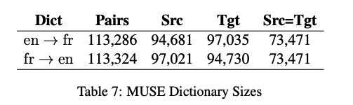
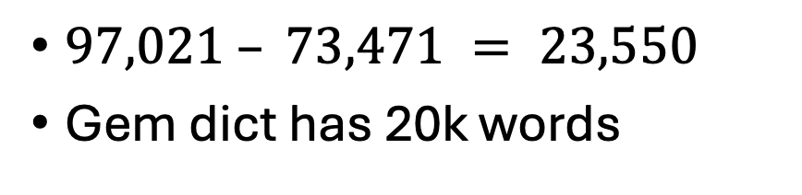
$97,021 – 73,471 = 23,550$
Gem dict has 20k words
SRC=TGT
FastText embeddings use spelling

Slide 39
Agenda for Part 1: History
Parallel Corpora
Applications:
Machine Translation (MT)
Word Sense Disambiguation (WSD)
Inappropriate Uses of Translation → Biases
Bilingual Lexicon Induction (BLI)

Slide 40
Agenda
Part 1: Current Status & Opportunities
Part 2: History
Part 3: Suggestions for future

Slide 41
Challenges for the Future
Lexical Semantics
Comparisons at word level
Compare and Contrast
Comparisons at document level
Contrasts in addition to comparisons
More Modalities
Words, Documents → Pictures, Audio, Video, etc.
Filter Bubbles
Comparable Corpora can help us get beyond Anglocentric Biases

Slide 42
BLI (Over)-Simplifies Lexicon
BLI assumes word-for-word translations (no phrases)
ask for
request
Distributional hypothesis
Corpora are all we need
You shall know a word by the company it keeps – Firth (1957)
No semantics, etymology, etc.
History has implications for contemporary language
But may be hard
to infer history from a corpus
of contemporary language
Etymology
1066 Norman Conquest
For a few hundred years
Peasants spoke Anglo-Saxon
Aristocracy spoke French
English → Anglo-Saxon + French
Word from French: higher register
Peasants raise
cows, calf, swine (Anglo-Saxon)
So aristocracy can eat
beef, veal, pork (French)

Slide 43
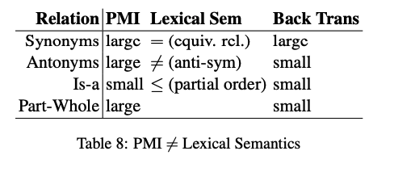
Lexical Semantics
Distributional hypothesis
Corpora are all we need
You shall know a word by the company it keeps – Firth (1957)
No semantics, etymology, etc.
PMI (pointwise mutual info)
Church & Hanks (1990)
PMI → Word2Vec → BERT/LLMs
PMI estimates collocations
Prob that two words appear near one another, normalized by chance
good / OK / bad
Back Translation
Random Walk over Translations
Good → Bien → OK → Tout marche bien → Everything works fine
But not, good → … → bad
Large PMI
Collocations:
Truth, Justice & American Way
Red, White and Blue
Synonyms: true / correct
Antonyms: true / false
Part-Whole: window /house

Slide 44
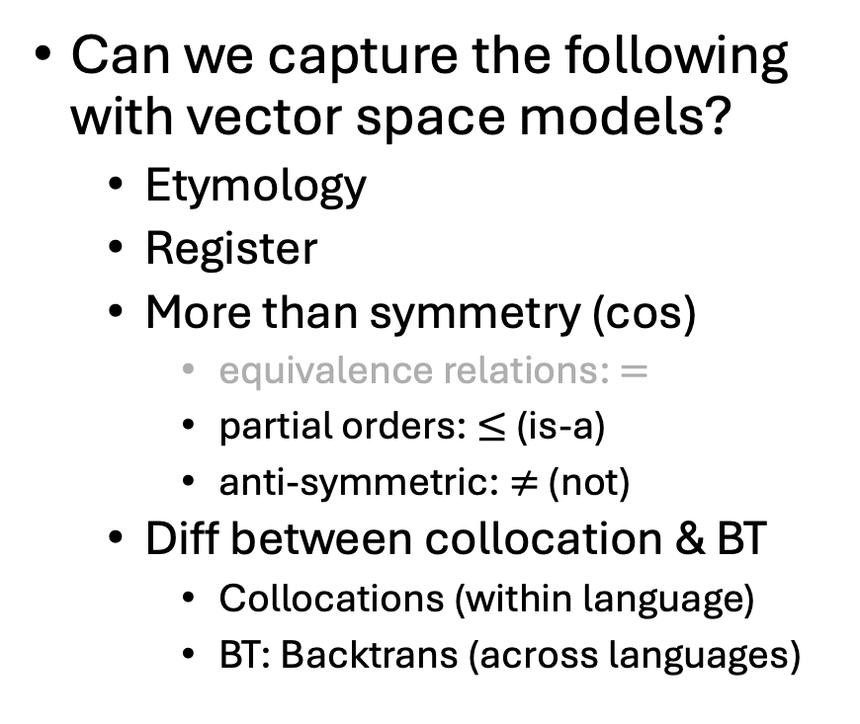
Lexical Semantics Challenges
Can we capture the following with vector space models?
Etymology
Register
More than symmetry (cos)
equivalence relations: $=$
partial orders:$≤$ (is-a)
anti-symmetric: $≠$ (not)
Diff between collocation & BT
Collocations (within language)
BT: Backtrans (across languages)

Slide 45
Challenges for the Future
Lexical Semantics
Comparisons at word level
Compare and Contrast
Comparisons at document level
Contrasts in addition to comparisons
More Modalities
Words, Documents → Pictures, Audio, Video, etc.
Filter Bubbles
Comparable Corpora can help us get beyond Anglocentric Biases

Slide 46
Compare and Contrast Task
Input two papers
maybe in the same language
(and maybe not)
Output snippets
summaries of each paper
as well as
similarities and
differences
Chatbots are ok
at summarization
though not as good as tldr
Chatbots are not ok
on similarities and
differences

Slide 47
Transfer Learning: Bootstrap LLMs to more languages
Good News
There are lots of papers in Semantic Scholar (S2)
in many languages
mostly translation-free
Challenge
Find comparable papers in high-resource languages

Slide 48
Tasks:
Find Comparable Papers
Compare and Contrast
Input: paper id
Output: Similar papers
Similar to recommendations
Input: two paper ids
Outputs:
Similarities
Differences
(and summaries of both papers)
Variations
Monolingual
Multilingual

Slide 49
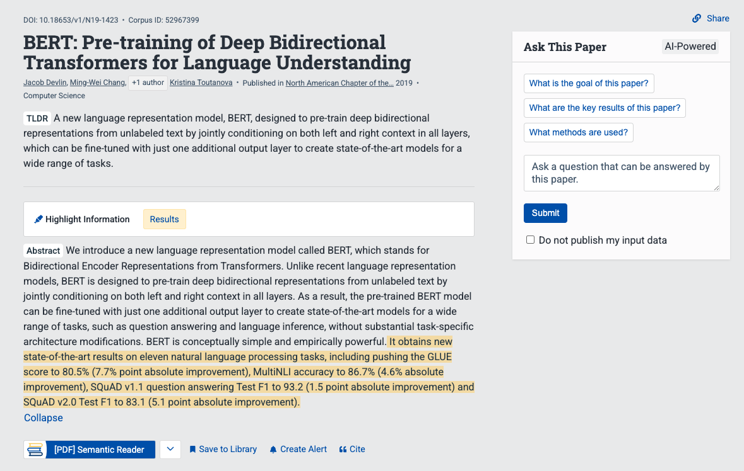
Snippet from Semantic Scholar
tldr
chat

Slide 50
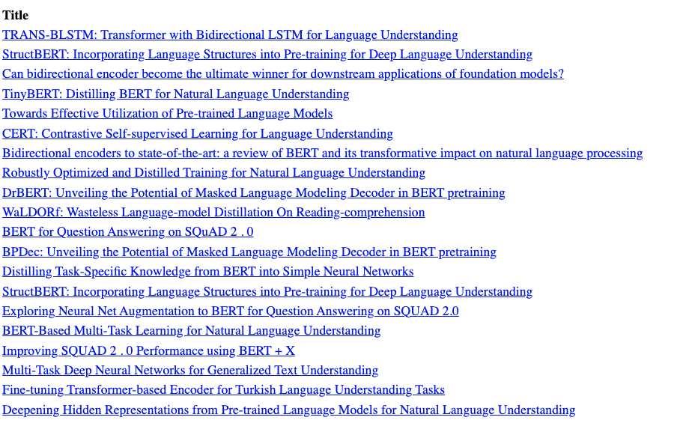
Recommendations: Query: BERT paper

Slide 51
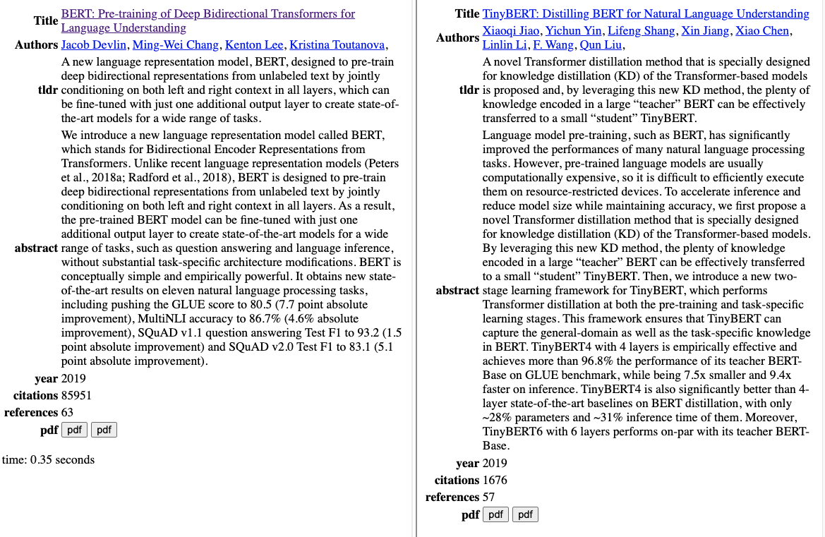
Summaries of Two Papers

Slide 52
What do I really want to ask this paper?
How does this paper compare with that paper?
What do they have in common?
How do they differ?
Similarities
Both BERT and TinyBERT use similar methods (transformers)
to encode text as vectors
Differences
TinyBERT is smaller, faster, cheaper
and almost as good

Slide 53
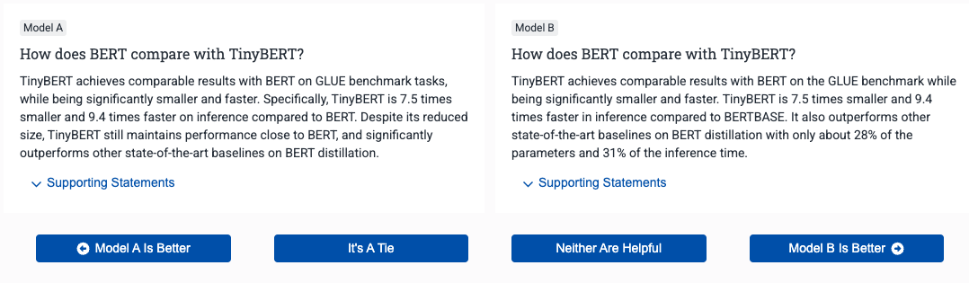
How does BERT compare with TinyBERT?
Source: S2
Similarities
Both BERT and TinyBERT use similar methods (transformers) to encode text as vectors
Differences
TinyBERT is smaller, faster, cheaper and almost as good
Target

Slide 54
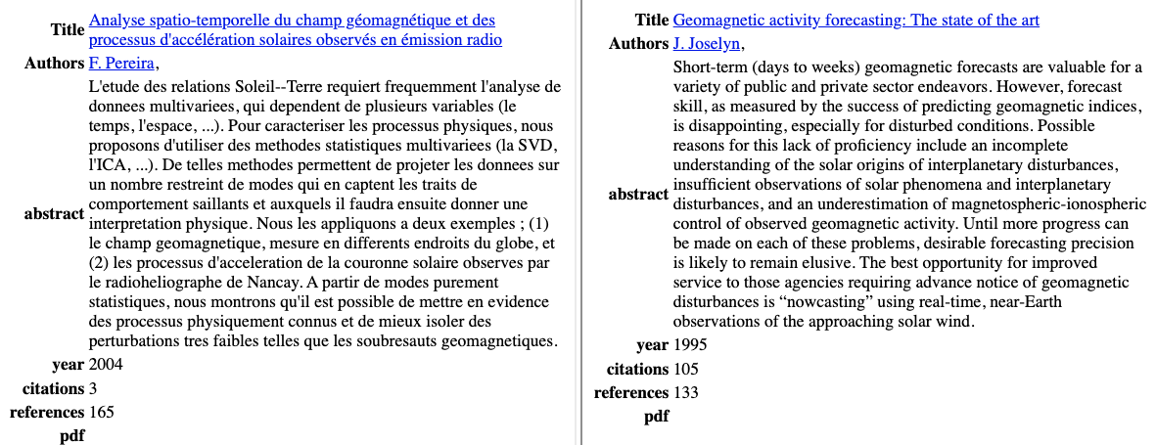
Multilingual Version: Please compare and contrast these two papers

Slide 55
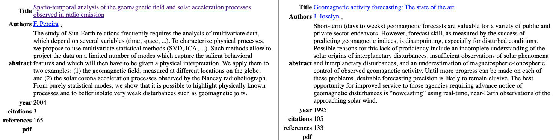
Multilingual Version (translation of previous slide) Please compare and contrast these two papers

Slide 56


tldr: Better in English than Chinese

Slide 57

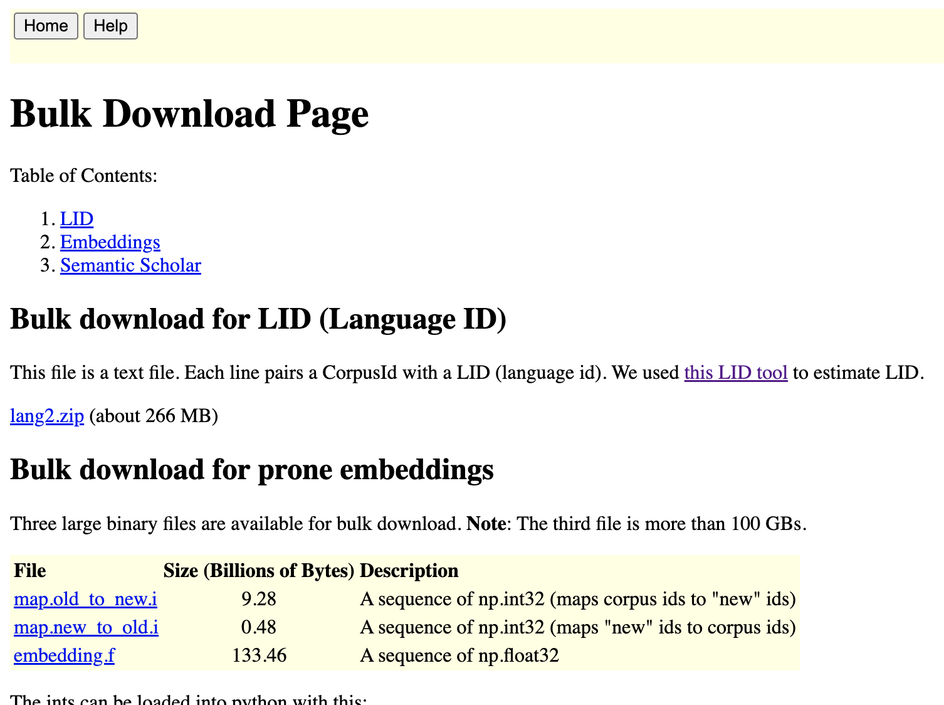

Shameless Plug: http://recommendpapers.xyz

Slide 58
Challenges for the Future
Lexical Semantics
Comparisons at word level
Compare and Contrast
Comparisons at document level
Contrasts in addition to comparisons
More Modalities
Words, Documents → Pictures, Audio, Video, etc.
Filter Bubbles
Comparable Corpora can help us get beyond Anglocentric Biases

Slide 59
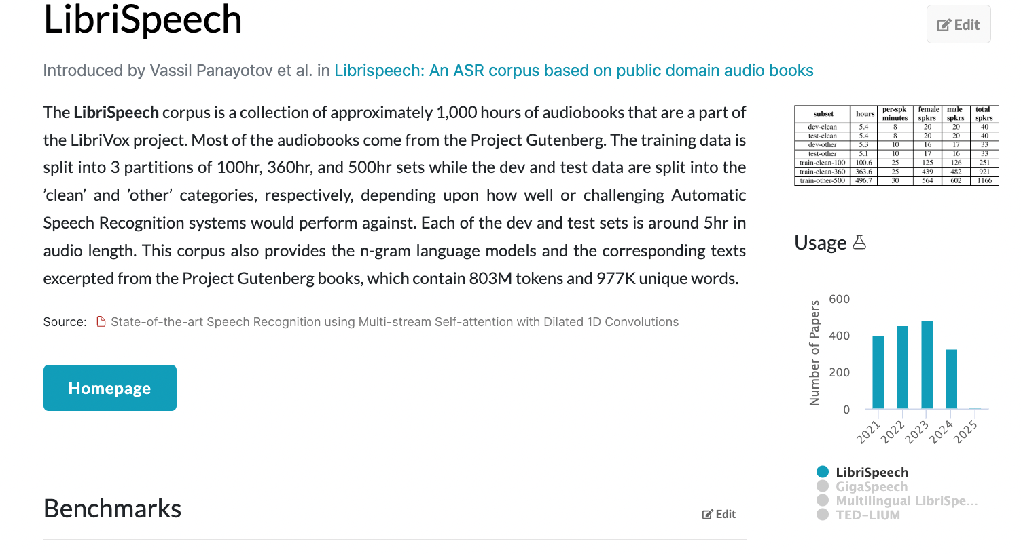
Multimodal Corpora: Text, Audio, Pictures, Video, etc.
A Multimodal Parallel Corpus
A Multimodal Comparable Corpus
Now that everything is a vector,
represent everything as vectors
answer all questions with ANN

Slide 60
Computational Linguistics & Vision Words, Documents → Pictures, Audio, Video, etc.
Perspective: Comparable Corpora
Perspective: Linguistics in Pictures
Now that everything is a vector,
represent everything as vectors
answer all questions with ANN
Data is data
English/French/Audio/Pictures
Communication is communication
Bias/Filter-Bubbles
Translation-Free
Perspective/Sentiment/Stance/Culture
COCO (facts) 👎
ArteLingo (opinions) 👍
Vocabulary
COCO (nouns you can see)
ArteLingo (richer vocab beyond what you can see)
Bounding Box Semantics 👎
Limit language to classifying pixels in a single box
But ambiguity, pragmatics, focus
Bounding boxes: like aligning parallel corpora 👎
(Too) convenient for computation
(Too) limiting to capture the facts

Slide 61
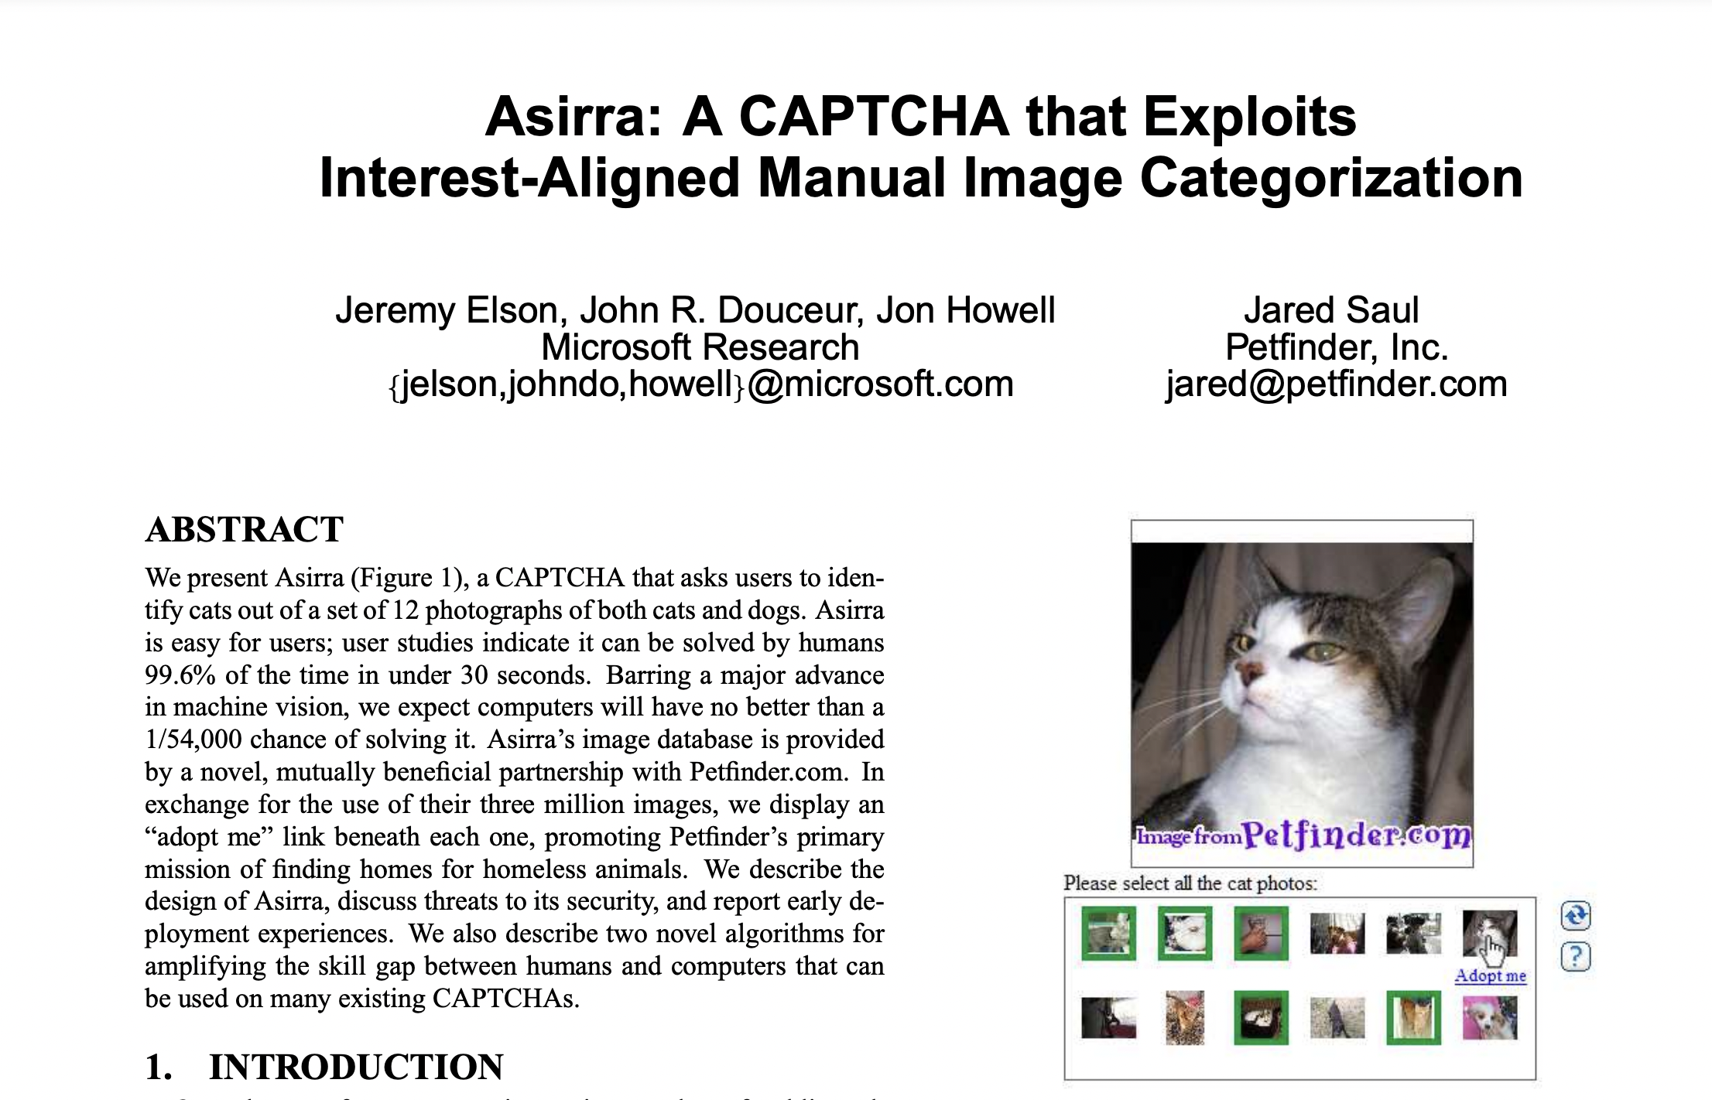
An Older View of Vision Research: Vision = Pixel Classification
https://www.microsoft.com/en-us/research/wp-content/uploads/2007/10/CCS2007.pdf

Slide 62
A More Modern View of Vision Research Task: End-to-End Image Captioning
###Human: <img> </img>
Could you describe the contents of this image for me?
Use <lang> words to describe the image
###Assistant:

Slide 63
A Translation-Free Benchmark (To avoid Anglo-Centric Biases)
Input:
Picture from WikiArt
Language (one of 28 languages)
Output Annotations:
9 Emotion Labels
4 Positive:
Contentment, Awe, Excitement, Amusement
4 Negative:
Sadness, Anger, Fear, Disgust
1 Neutral
Caption (in your language)
EMNLP-2024

Slide 64
Task for Machine (Similar to Human Annotation Task)
Input:
Picture from WikiArt
Language (one of 28 languages)
Output Annotations:
9 Emotion Labels
4 Positive:
Contentment, Awe, Excitement, Amusement
4 Negative:
Sadness, Anger, Fear, Disgust
1 Neutral
Caption

Slide 65
Embrace Diversity & Multiple Perspectives
emotion labels:
disgust (Burmese)
awe (Malay)
captions focus
on chest
Burmese & Malay
on face and hair
Korean & Setswana
Hypothesis:
Predictable
Ethics Review

Slide 66
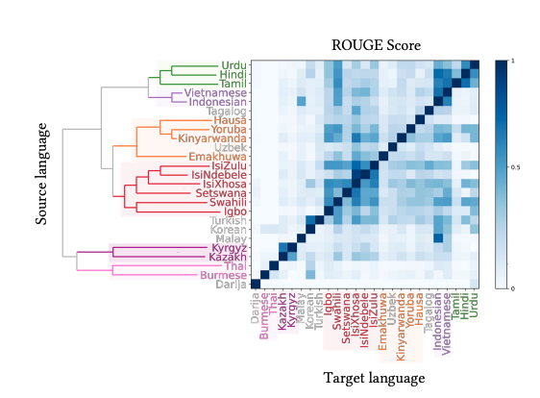
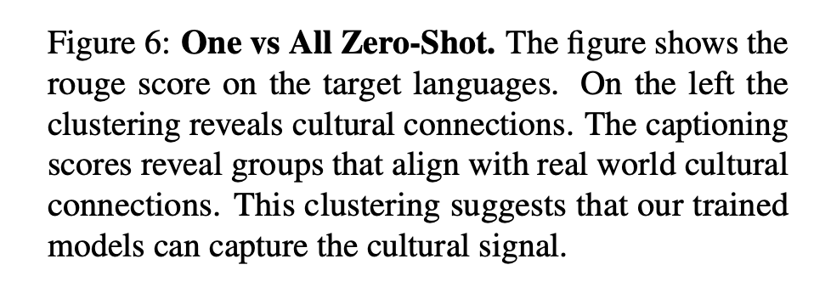
Evidence:
Predictable

Slide 67
Vision: More than Pixels Communication (Shannon): Audience Matters
Art is a form of communication
between artist and audience
Background matters
Language
Culture
Task: Art, Lang → Caption
English pivot baseline:
Translate caption from English
Can we beat that?

Slide 68
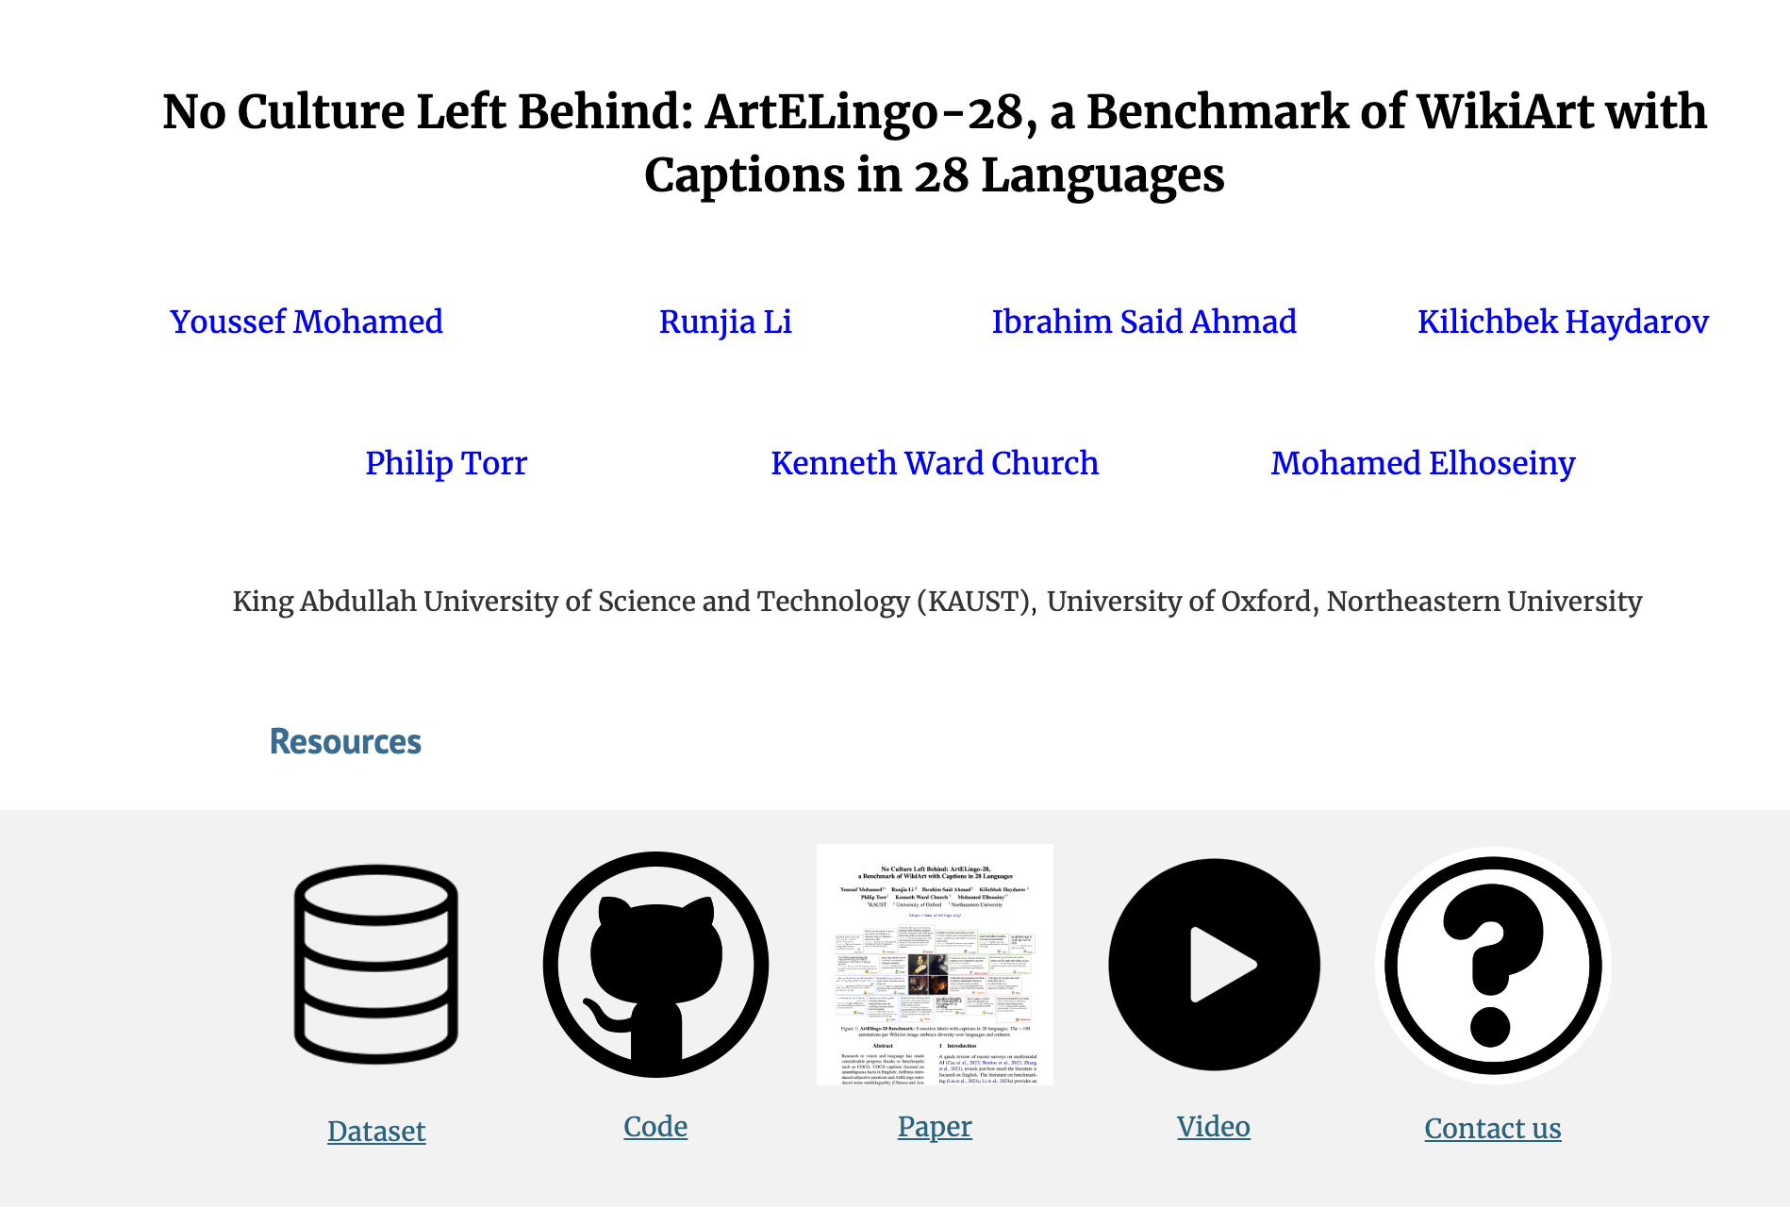

Website: Benchmark, Code, Paper & Video

Slide 69
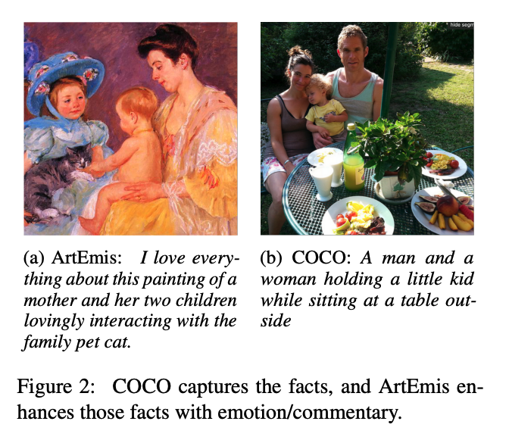
Adding Perspective to Speech/Vision Research COCO (Objective) → ArtEmis (Subjective)
Subjective Emotion
Objective
Facts
More room for Audience Background:
Culture/Language
Nouns: man, woman, kid, table
Modifiers: love, interacting, family

Slide 70
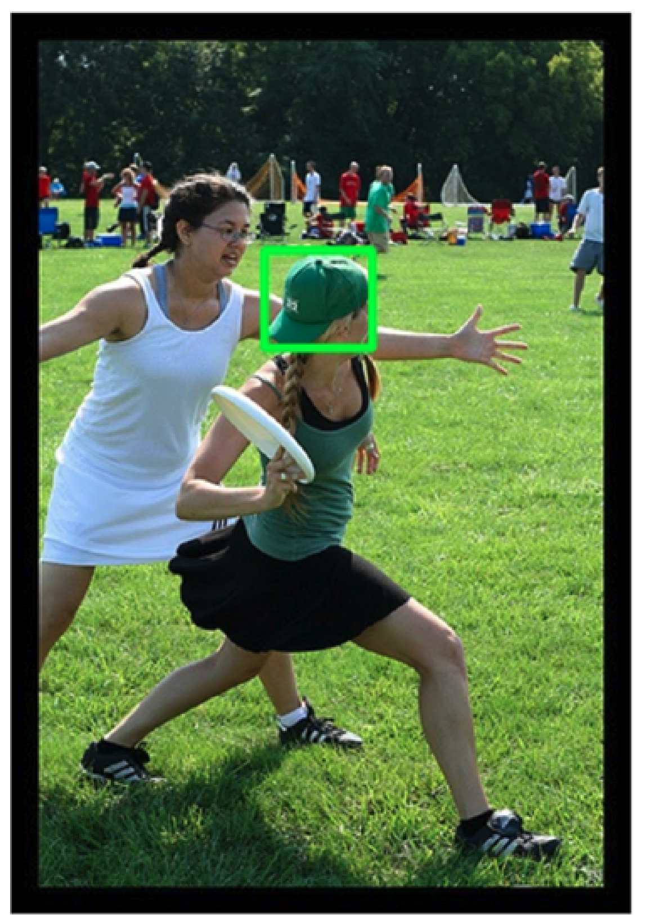
Pragmatics
Candidate labels: baseball cap, cap, green hat, hat, head.
Can you guess which one is in the gold standard?
Head is weird
Because it serves no useful purpose to mention that.
(You might mention that if one of the girls were headless)
Purposes of modification (Grice)
Descriptive
Discrimination
Green vs. White
Hat vs. No Hat
Offense vs. Defense
One Bounding Box vs. Two?
One: describe what is inside the box
Two: compare and contrast

Slide 71
Focus/Emphasis/Composition: Foreground vs. Background
Focus (leading role): Frisby, Throw, Offense
Supporting role: Defense
Background: Spectators
Photographer tells us
what’s central
and what isn’t

Slide 72
Verbs, Subjunctive, Focus, Perspective, etc…
Pictures vs. Videos
Captions on pictures have more nouns (you can see):
girl with green hat
Captions on videos have more verbs:
girl throwing frisbee
Possible Worlds: Subjunctive, Hedges
The girl on defense might block the throw,
but probably won’t
Bounding boxes discourage editorializing
Few words not explicitly grounded to a single box
Few opinions, comparisons, contrasts, predicates (verbs/adjectives), possible worlds
Bounding boxes are like aligning parallel corpora
(Too) convenient for computation
(Too) limiting to capture the facts

Slide 73
More Predicates/Perspectives (without boxes) (Predicates = Verbs/Adjectives)

Slide 74
Challenges for the Future
Lexical Semantics
Comparisons at word level
Compare and Contrast
Comparisons at document level
Contrasts in addition to comparisons
More Modalities
Words, Documents → Pictures, Audio, Video, etc.
Filter Bubbles
Comparable Corpora can help us get beyond Anglocentric Biases

Slide 75

Emerging trends: When can users trust GPT, and when should they intervene?
Usage of LLMs and chat bots will continue to grow,
since they are so easy to use,
and so (incredibly) credible.
This article describes a homework assignment,
where I asked my students to use bots to write essays.
Too many essays
should have been fact-checked.
Factchecking is
too much trouble.

Slide 76
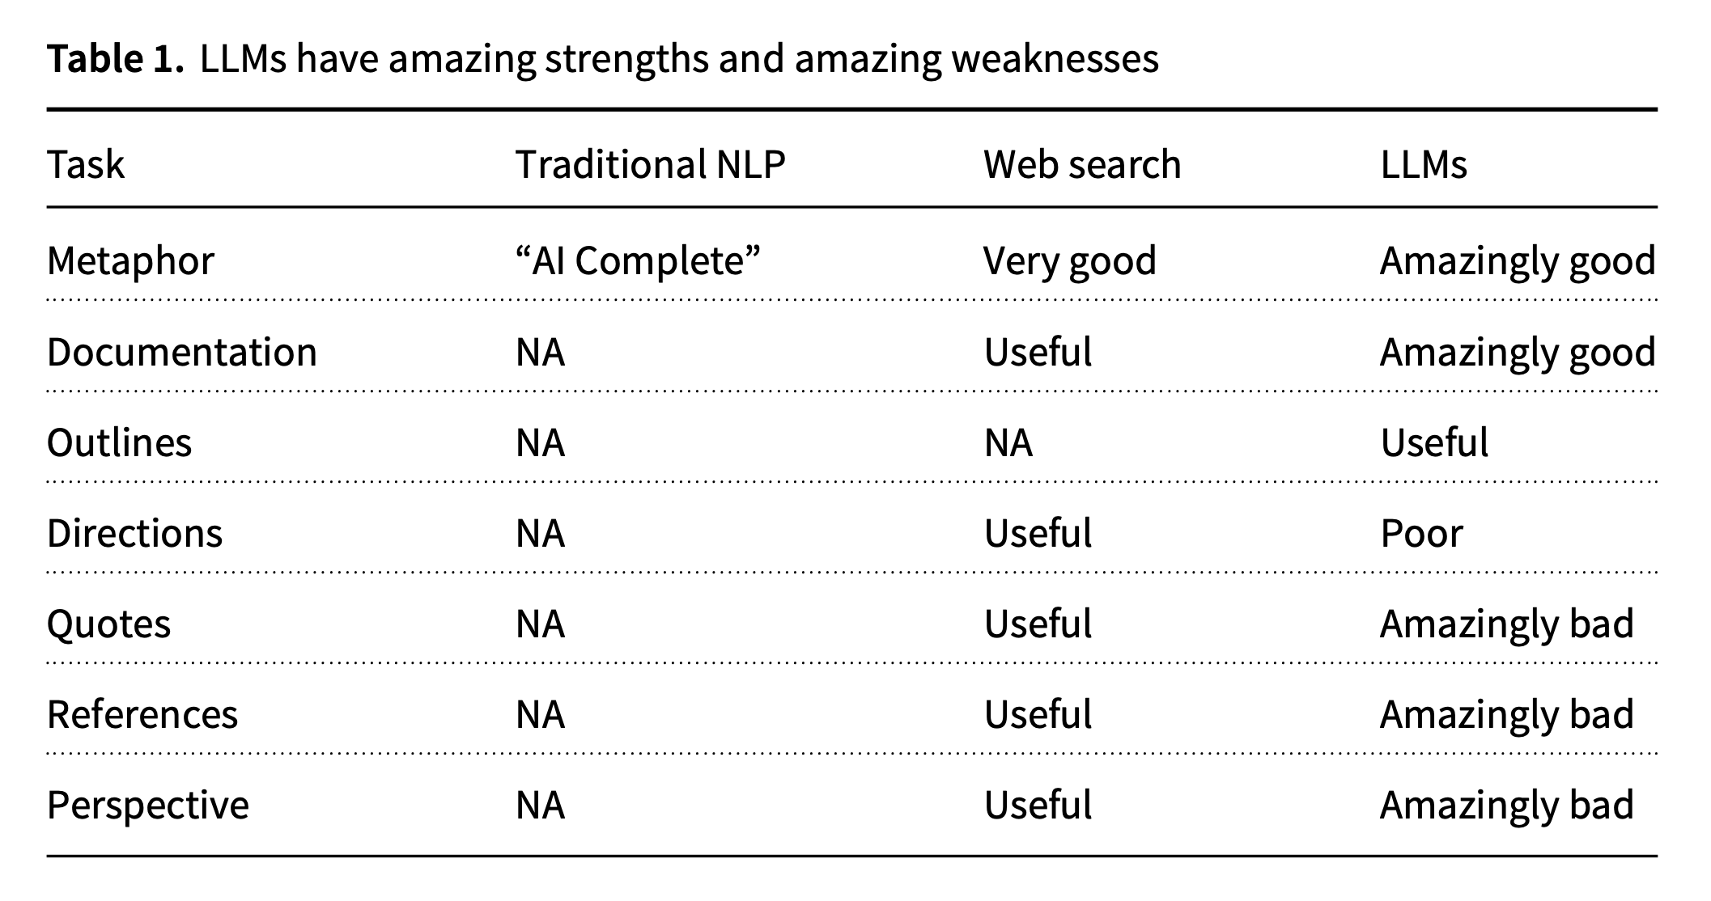

Slide 77
Amazingly Good: Metaphor
cover all the bases
drop the ball
dunk
fumble
get on base
hit a home run
out in left field
punt (as a verb)
ragging the puck
run out the clock
sticky wicket
strike out

Slide 78

Amazingly Good: Metaphor
cover all the bases
drop the ball
dunk
fumble
get on base
hit a home run
out in left field
punt (as a verb)
ragging the puck
run out the clock
sticky wicket
strike out

Slide 79
Amazingly Bad: Anglo-Centric Biases
Homework assignment
Write essays on Opium Wars
from six perspectives
including East and West
Chatbots view everything
from a single (American) perspective
Hope: international students would rewrite output from bots
But that was too much work
All essays reflect Western perspective
Bots made in America do not mention
“Century of Humiliation”
A view that is motivating efforts
to compete with West in AI
When bots over-simplify the truth,
and take our side of a conflict,
that could be dangerous
and could lead to a trade war,
or worse

Slide 80

Ambitious Goal for Bots
Bots should be
competitive with historians
Appreciate history from multiple perspectives
as well as implementations for contemporary audience
Blurb:
“but also for anyone
seeking to understand the explosive intersection
between trade and politics today”

Slide 81
Conclusions: Challenges for the Future
Lexical Semantics
Comparisons at word level
Compare and Contrast
Comparisons at document level
Contrasts in addition to comparisons
More Modalities
Words, Documents → Pictures, Audio, Video, etc.
Filter Bubbles
Comparable Corpora can help us get beyond Anglocentric Biases

Slide 82
Backup

Slide 83
Challenges for Future
More depth:
CC are normally used for simple tasks such as
bilingual lexicon induction (BLI),
but CC can be used for much more interesting views of
lexical semantics.
Compare and Contrast:
CC are normally used to make compare over language pairs,
but they can be used for
contrasts as well as comparisons
in monolingual settings
as well as multilingual settings.
More modalities:
Now that vectors encode everything
text in many languages,
pictures, audio, video,
we can compare and contrast
everything with everything.
Bursting filter bubbles:
Bots made in America
are trained on corpora from an American perspective
with American biases.
We should not impose
American values on others.

Slide 84
More Predicates/Perspectives (Predicates = Verbs/Adjectives)

Slide 85


Slide 88
Boot-Strapping (Transfer Learning)
Boot-Strapping
Take advantage of high resource languages
To make progress on growth languages
Three Boot-Strapping Tasks: Learn Models in Growth Lang
Zero-Shot
No fine-tuning on data in target language
Few-Shot:
Fine-Tune with a little data in target language
One-vs-All Zero-Shot

Slide 89
Computational Linguistics & Vision Words, Documents → Pictures, Audio, Video, etc.
Perspective: Comparable Corpora
Perspective: Linguistics in Pictures
Now that everything is a vector,
represent everything as vectors
answer all questions with ANN
Data is data
English/French/Pictures
Communication is communication
Bias/Filter-Bubbles
Translation-Free
Perspective/Sentiment/Stance
COCO (facts) 👎
ArteLingo (opinions) 👍
Vocabulary
COCO (nouns you can see)
ArteLingo (more verbs, adj)
Bounding Box Semantics 👎
Ambiguity
Pragmatics: Grice
Focus/Emphasis:
Foreground vs. Background
Count Nouns vs. Mass Nouns
Bounding boxes are like aligning parallel corpora
(Too) convenient for computation
(Too) limiting to capture the facts

Slide 90

BLI (Over)-Simplifies Lexicon
BLI assumes word-for-word translations (no phrases)
ask for
request
Distributional hypothesis
Corpora are all we need
You shall know a word by the company it keeps – Firth (1957)
No semantics, etymology, etc.
Etymology
1066 Norman Conquest
English → Anglo-Saxon + French
French word has higher register
Peasants raise
cows, calf, swine (Anglo-Saxon)
So aristocracy can eat
beef, veal, pork (French)
Hypo: V+P are hard for L2 learners
because P depends on etymology
ask for (Anglo-Saxon)
request (French)
re $≈$ for
quest $≈$ ask

Slide 91
Despite risks (hallucinations, etc.),
usage of ChatGPT will almost surely grow,
since it is so easy to use,
and so (incredibly) credible.
I would be more comfortable with this reality if
we encouraged more humans-in-the-loop,
with a better characterization of
when the machine can be trusted and
when humans should intervene.
We have seen that LLMs (and ChatGPT) have much to offer and
can be a useful tool for students.
However, there are risks.
Users of LLMs, including students and everyone else, should be made aware of
strengths (fluency)
and weaknesses (trustworthiness).
Users should be expected to do their own fact-checking before trafficking in misinformation.
Laziness is inexcusable. Users are responsible for what they say, whether or not it came from a chat bot.
That said, realistically, laziness is also inevitable.
Chat bots are not going away.
If others are conservative with the truth and with fact-checking, then we will become conservative with belief. Credibility may disappear before chat bots go away.

Slide 92
Use Cases for Machine Translation (Baidu)
Students want help with homework
Help writing CV in English
Logs are full of requests to translate phrasal verbs from English to Chinese
Students are trying on preposition after another
There must be better ways to address these use cases

Slide 93
Corporate Cultures Have Consequences
AT&T Bell Labs: Telephones, Unix, Transistor
Reliability: Design for five 9s (defects per million: 99.999%)
https://en.wikipedia.org/wiki/Unix_philosophy
Small is beautiful
Write programs that do one thing and do it well.
Write programs to work together
Testing > Project Management > Dev
Microsoft: Windows & Office
Features/Scenarios
Jack of all trades; master of none (99%)
Dev > Project Management > Testing
Baidu: Web Search
Deep understanding of the market in China

Slide 94
Use Cases for Machine Translation (Baidu)
Students want help with homework
Help writing CV in English
Logs are full of requests to translate phrasal verbs from English to Chinese
Students are trying on preposition after another
There must be better ways to address these use cases
Microsoft View

Slide 95

An Aside about logs
Economic View of Search
Privacy
Search engine is a market maker
Goal: Find an equilibrium
Readers (demand for content)
Writers (suppliers of content)
Advertisers ($$)
Spammers
It is said: web crawls are huge,
but when content is successful,
there are more readers than writers
and therefore logs >> crawls
Narrative is: China is …
Reality:
Industry in China is careful;
Penalties are severe
My access to logs was more limited in China than US
New York Times

Slide 96

Future Research on Transfer Learning
Decrease similarity
Multi-modal LLM
E2E IMG CAPTIONNING
###Human: <img> </img> Could you describe the contents of this image for me? ###Assistant:
###Human: <img> </img> Could you describe the contents of this image for me? Use <lang1> and <lang2> words to describe the image ###Assistant:

Slide 97

One-vs-All Zero-Shot
Aim: Study languages pairwise
We fine-tune the Zero-Shot model on one language,
and evaluate on all others
For example,
let model $x$ be fine-tuned on Hindi,
while model $y$ is fine-tuned on Hausa.
Evaluate both models on Urdu.
If both models perform similarly,
then there is no underlying cultural relationship between Hindi or Hausa with Urdu.
However, we learn that
Hindi is more like Urdu
than Hausa

Slide 99
Embrace Diversity & Multiple Perspectives
emotion labels:
disgust (Burmese)
awe (Malay)
captions focus
on chest
Burmese & Malay
on face and hair
Korean & Setswana
Hypothesis:
Predictable

Slide 100
Vision: More than Classification on Pixels Communication (Shannon): Audience Matters
Art is a form of communication
between artist and audience
Background matters
Language
Culture
Task: Art, Lang → Caption
English pivot baseline:
Translate caption from English
Can we beat that?

Slide 101
Adding Perspective to Speech/Vision Research COCO (Objective) → ArtEmis (Subjective)
Subjective Emotion
Objective
Facts
More room for Audience Background:
Culture/Language

Slide 102



Deliverables
Scientific publications
Establish that we can beat
baseline of pivoting via English
Models
Source code
https://github.com/speechbrain/speechbrain
language-agnostic semantic speech encoder (training+inference)
speech expressivity embedding extractor (training+inference)
Packaged tools for global media monitoring
semantic pairing + polarity
Vectors → URLs → Copyrighted Material

Slide 103

Conclusions
Scientific Merit
Boot-Strap from High Resources to Growth Opportunities
Beat pivoting via English
Impact
Deliverables
Global Media Monitoring
Audio → Vectors → URLs → Copyrighted Material
Progress on Growth Languages
Feasibility
EMNLP paper
Novelty
Avoid Pivoting via English
Synergy
Out-reach beyond speech
Unified view for growth languages over modalities:
Speech
Vision
Language

Slide 104


Vision: Facts → Opinions
Facts
Opinions

Slide 105


No Language Left Behind (NLLB)

Slide 106


Slide 107
Few Shot & Zero Shot

Slide 108
Anglo-Centered Baseline
Use English as Pivot Language
Anglo-Centered Vision Task:
Input: Picture
Output: English Caption
If you want a caption in another language:
Just translate English caption to that language
Challenge:
Can we do better than that?

Slide 109


Agreement (A) on Emotion Labels: More A: Landscapes → Less A: Sketches

Slide 110
Agreement on Emotion Labels
By Genre
By Language (or perhaps Education?)

Slide 111
Agenda
PMI
Word2Vec: Factored PMI
BERT
Multi-lingual & Multi-modal BERT
One Model to RULE THEM ALL???
VAD: Latent Dimensions → Interpretable Dimensions

